Slide 1
Introduction to Data Science Project
BY-
Ayush Kuruvilla (PES2201800509)
Isha Arora (PES2201800130)
Ayushi Agarwal (PES2201800053)

Slide 2
DATA CLEANING
Data cleaning is the process of detecting and correcting corrupt or inaccurate records from a record set, table, or database and refers to identifying incomplete, incorrect, inaccurate or irrelevant parts of the data and then replacing, modifying, or deleting the dirty or coarse data.
All the NaN’s for categorical columns to be replaced with its previous row values
All the NaN’s for numerical columns to be replaced with average of the column.

Slide 3
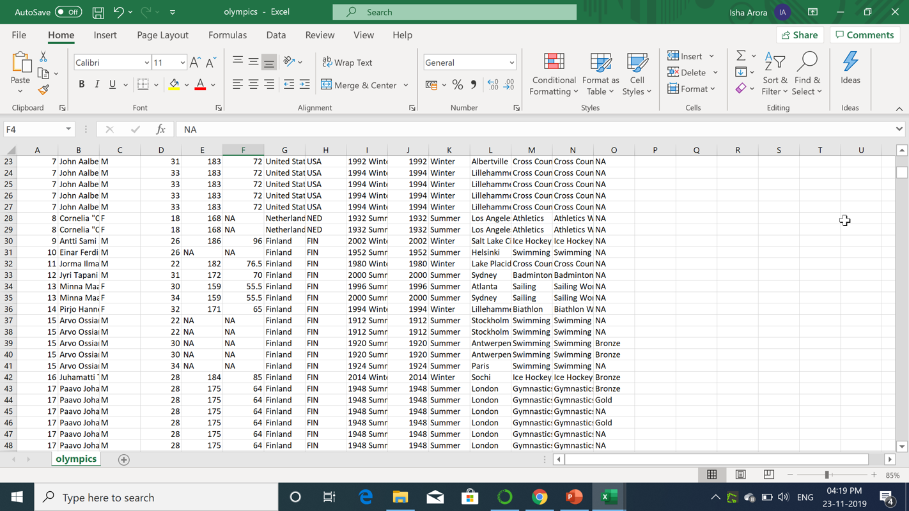
Before Data Cleaning (actual dataset)

Slide 4
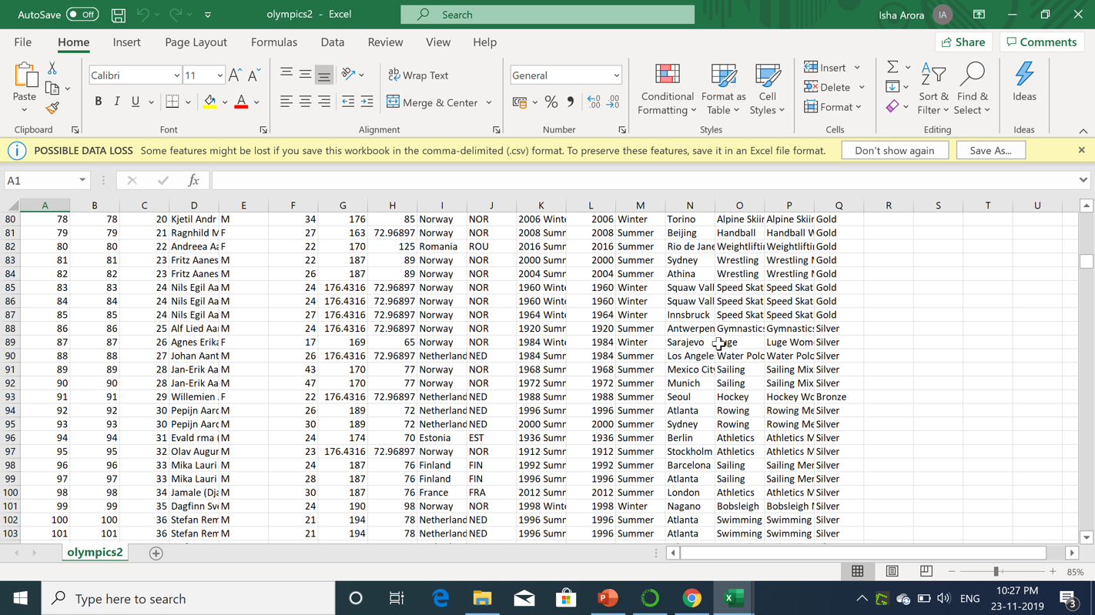
After data cleaning

Slide 5
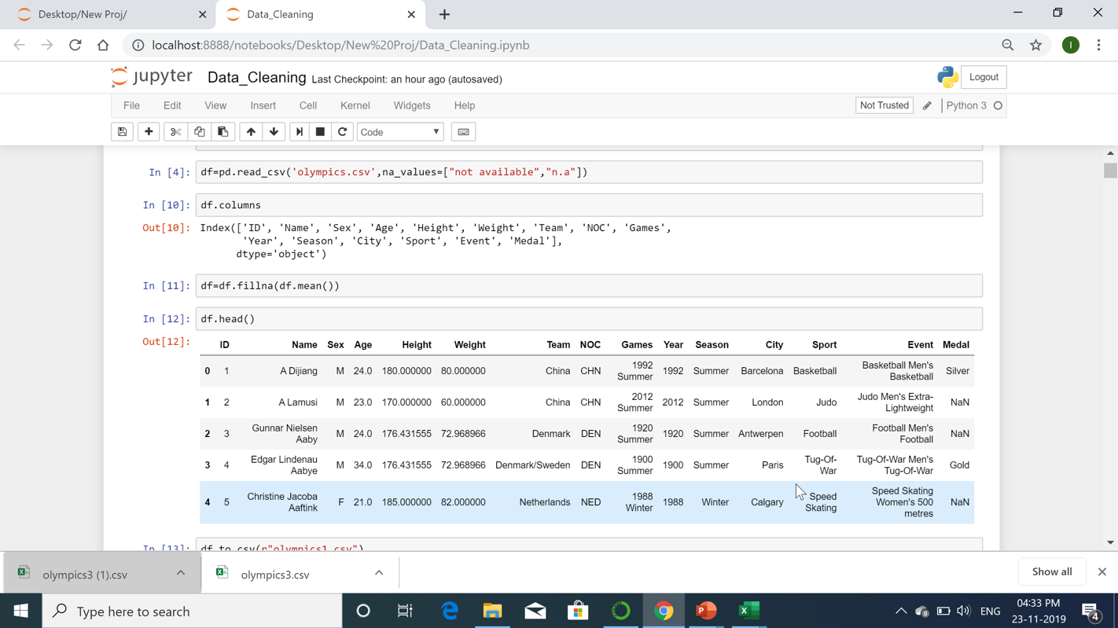
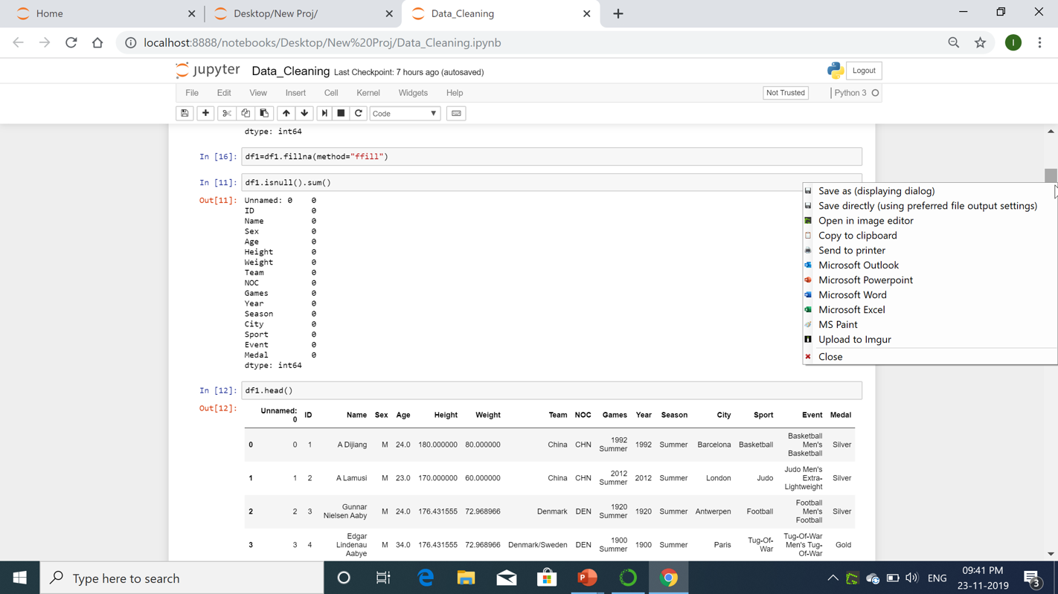
Code Snippet for numerical data

Slide 6
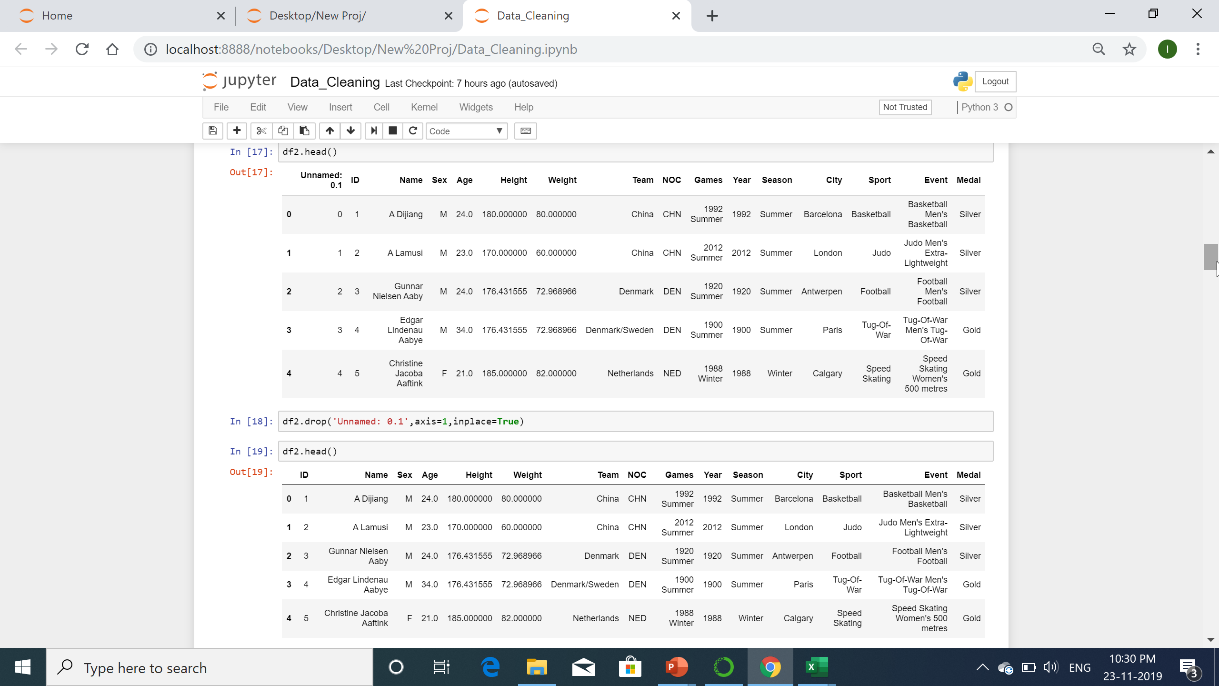
After categorical and numerical data cleaning

Slide 7
NORMALISATION AND STANDARDISATION
Normalization is a database design technique which organizes tables in a manner that reduces redundancy and dependency of data.
It divides larger tables to smaller tables and links them using relationships.

Slide 8
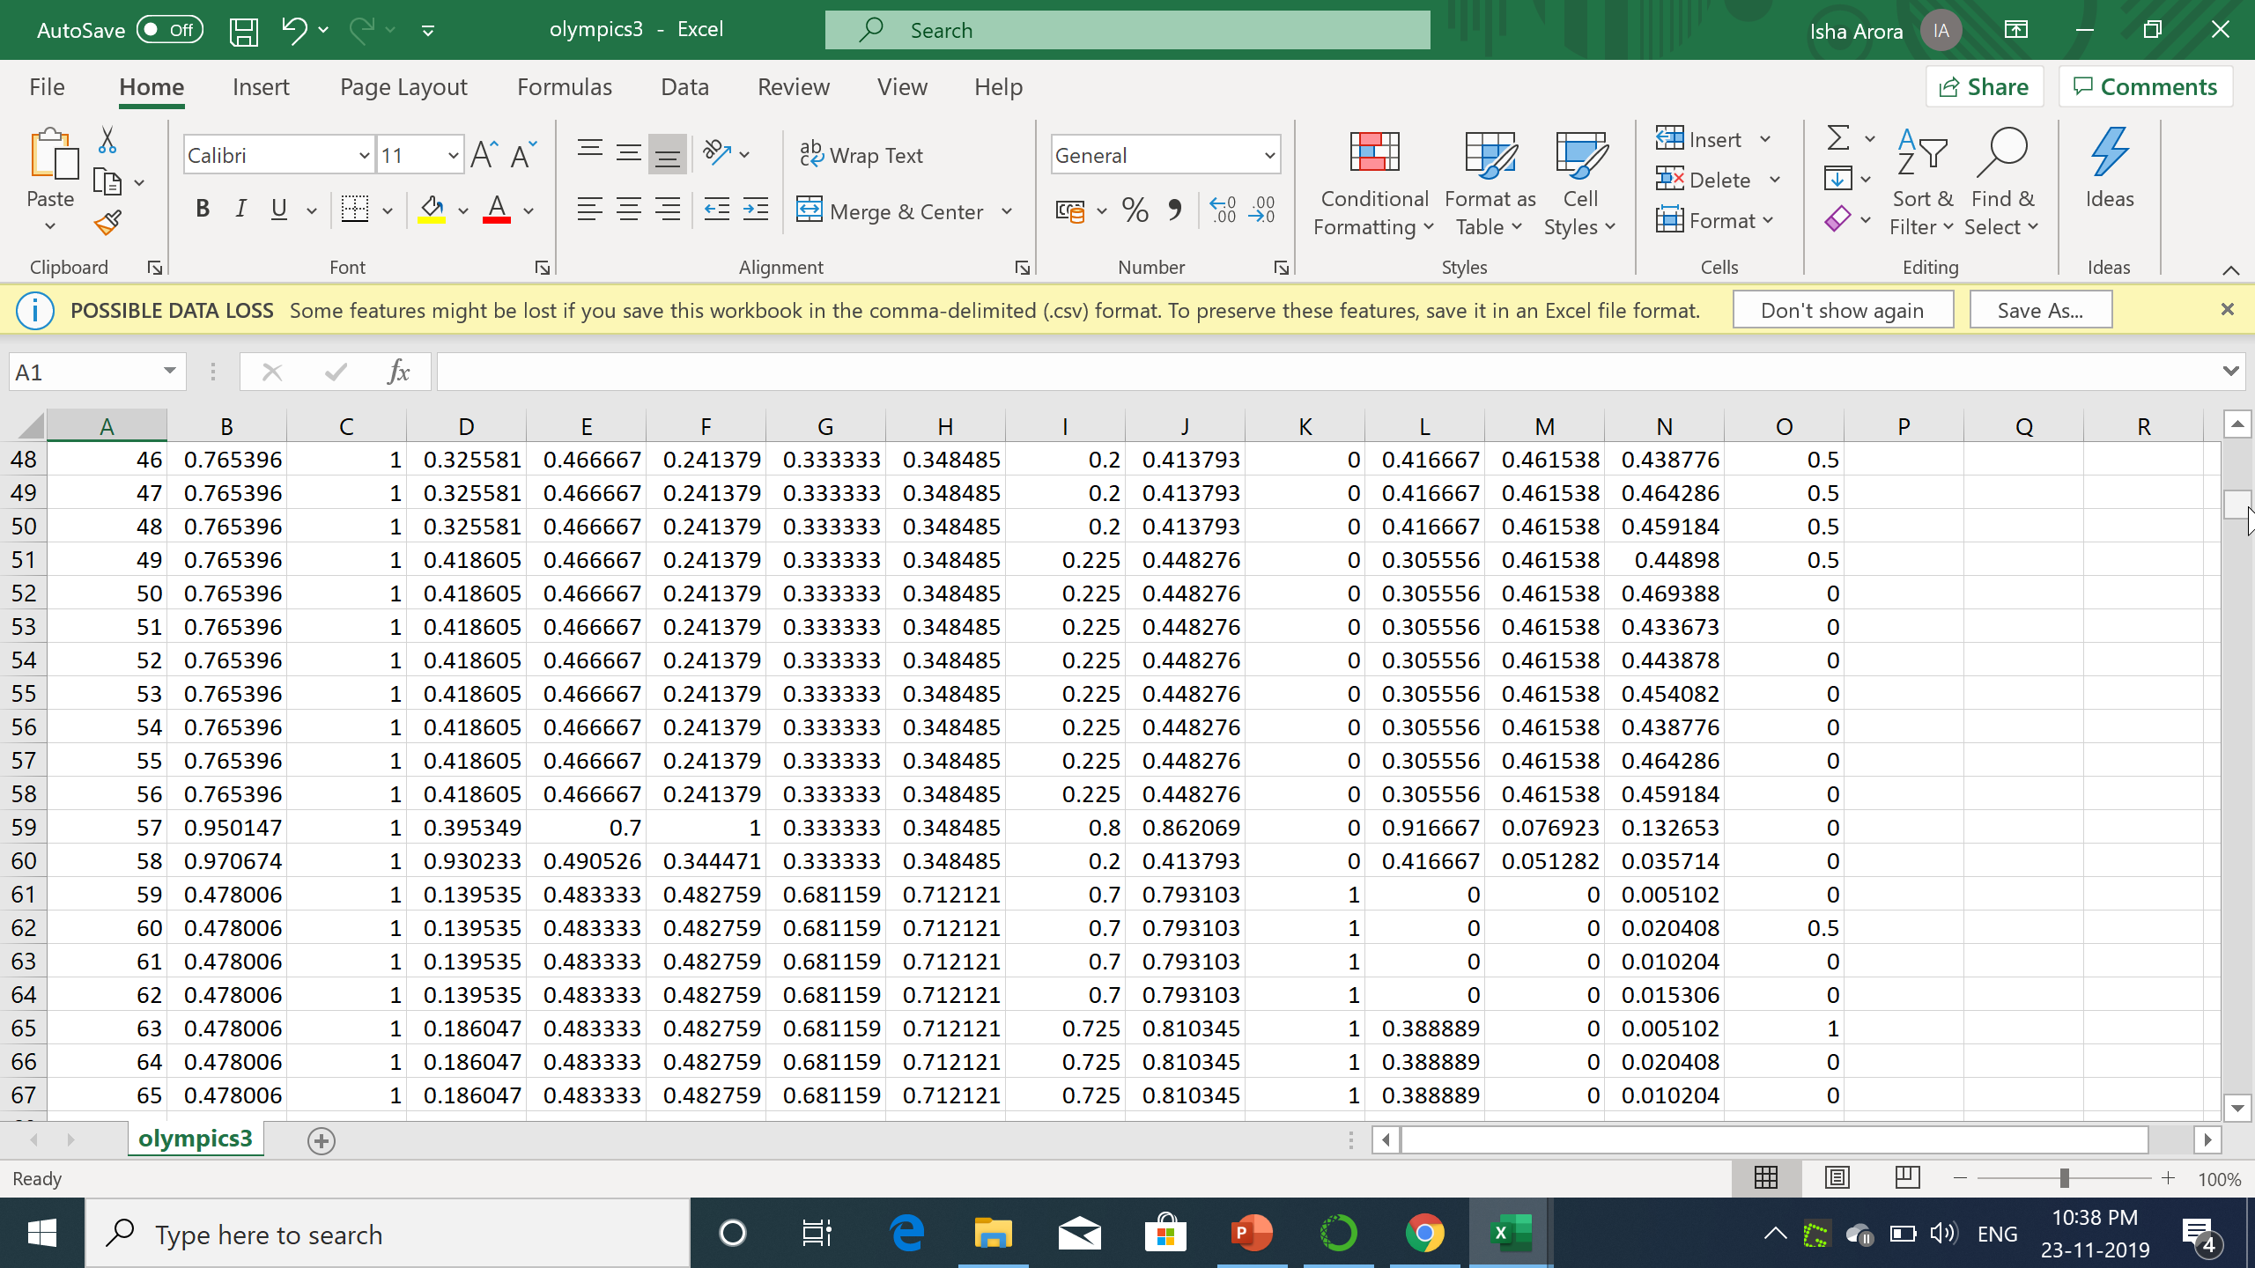
Before and after normalization

Slide 9
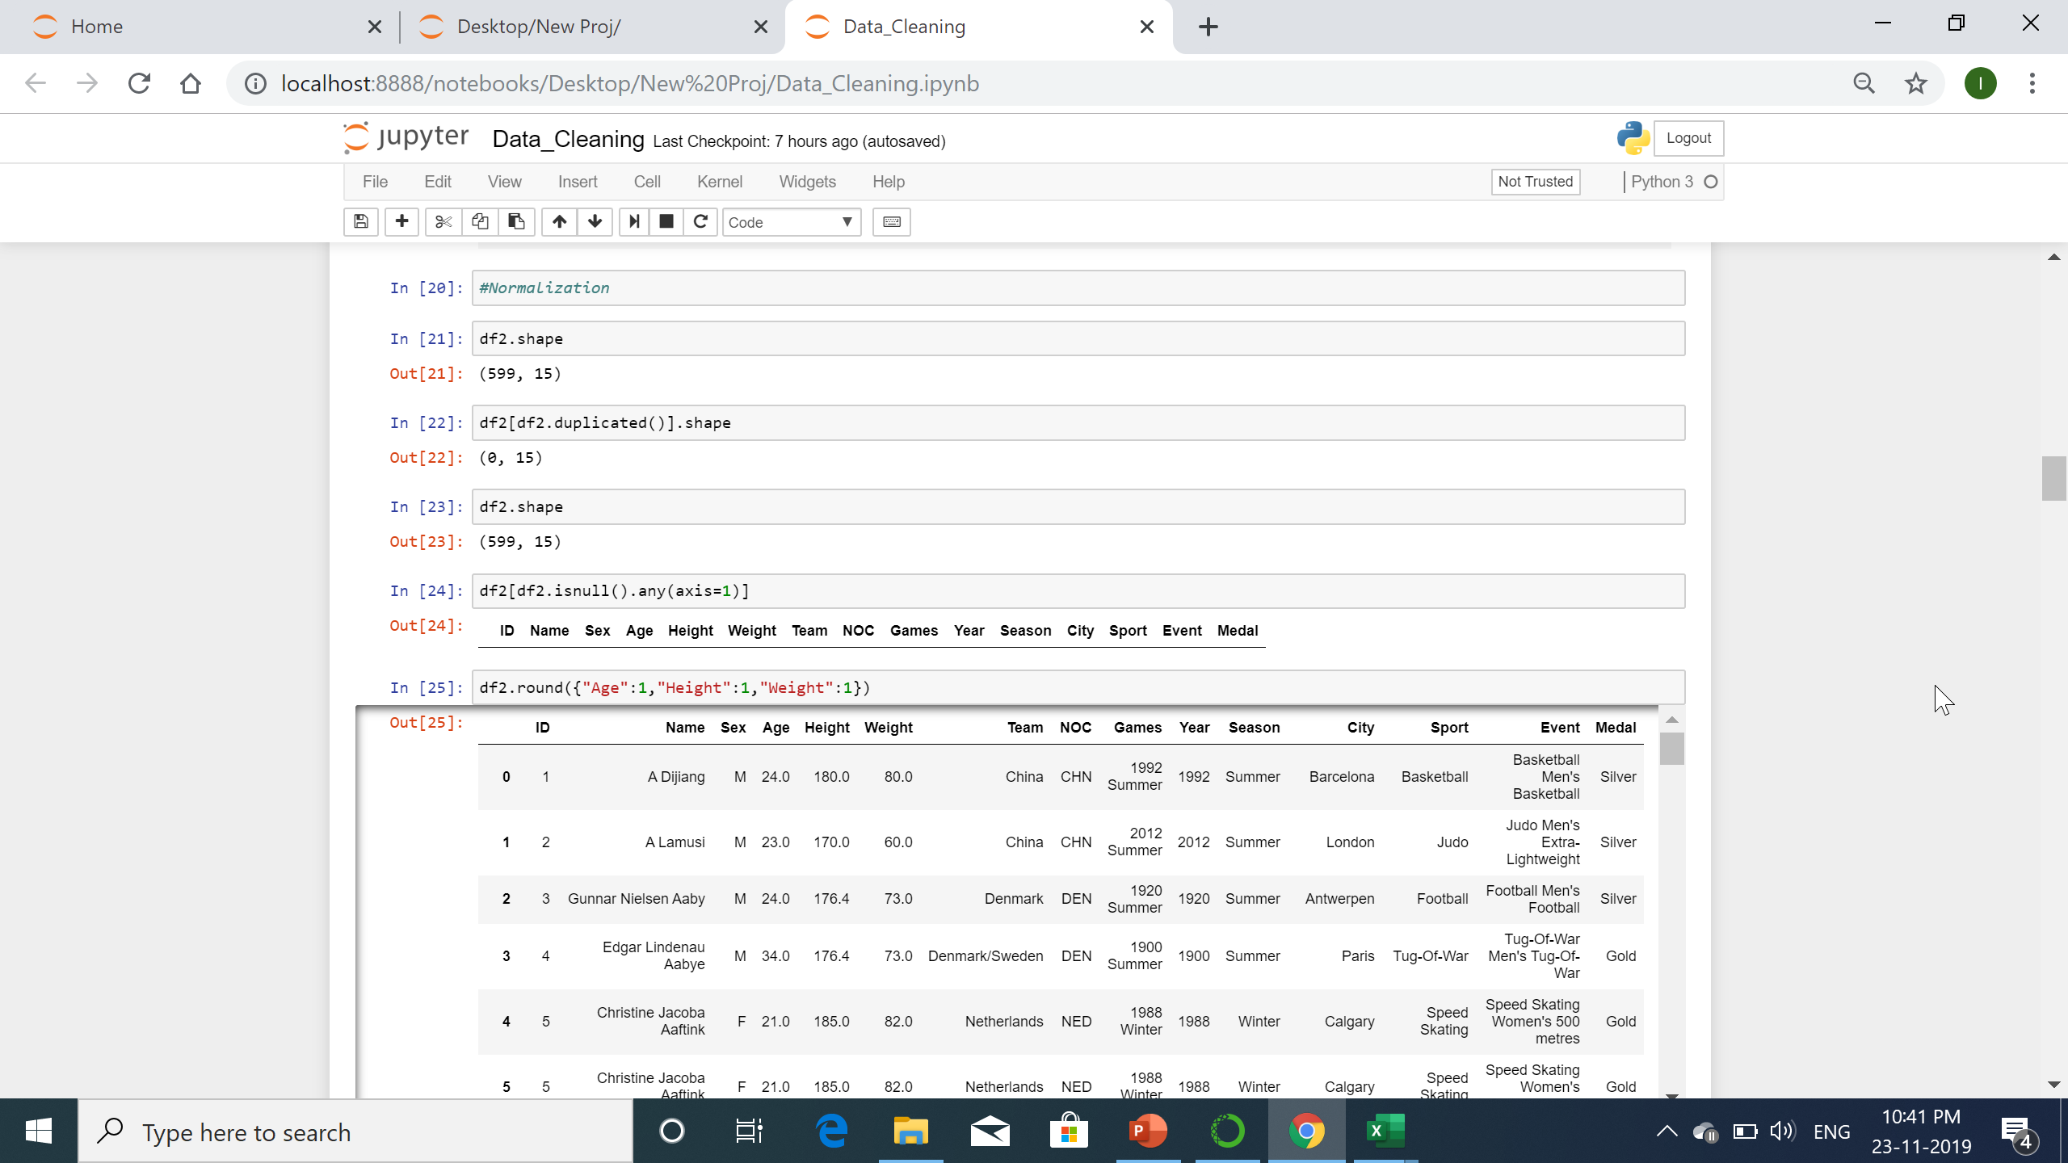
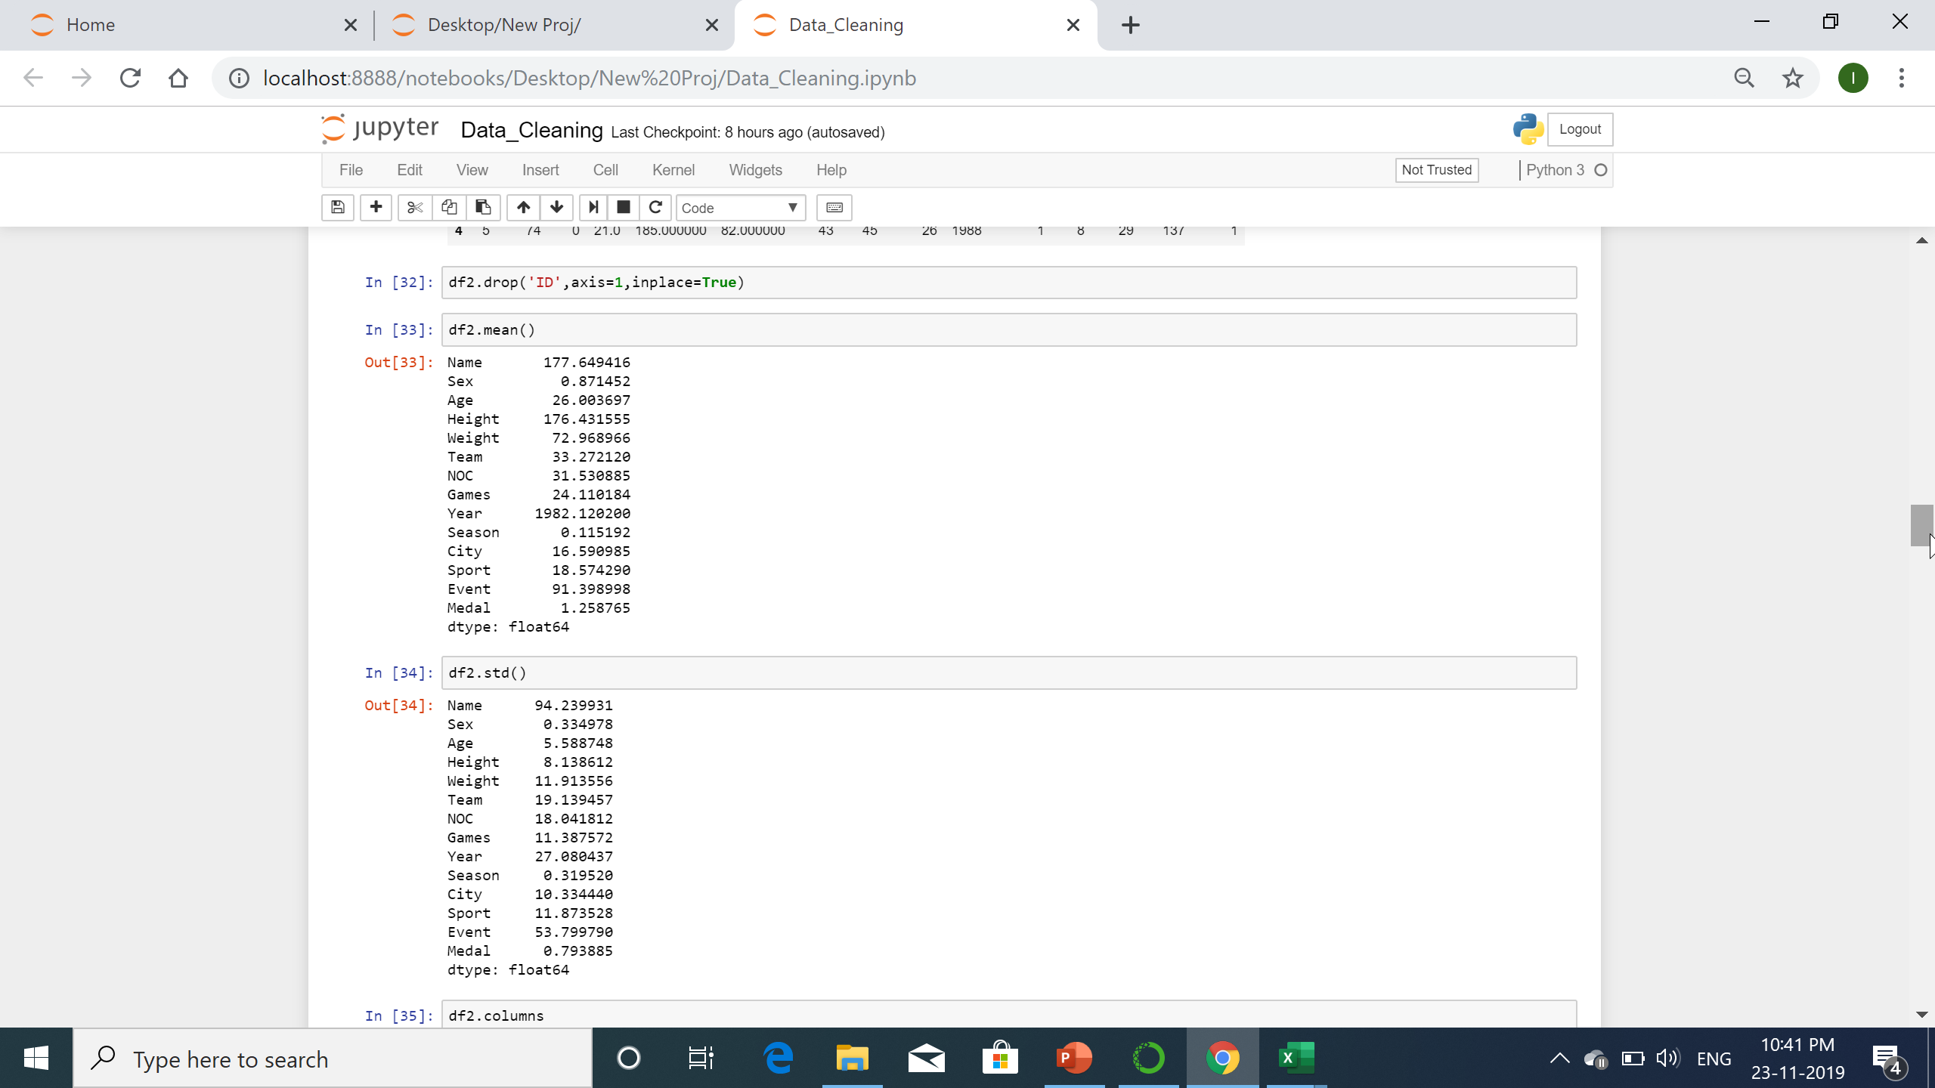
Code snippet used for normalization

Slide 10
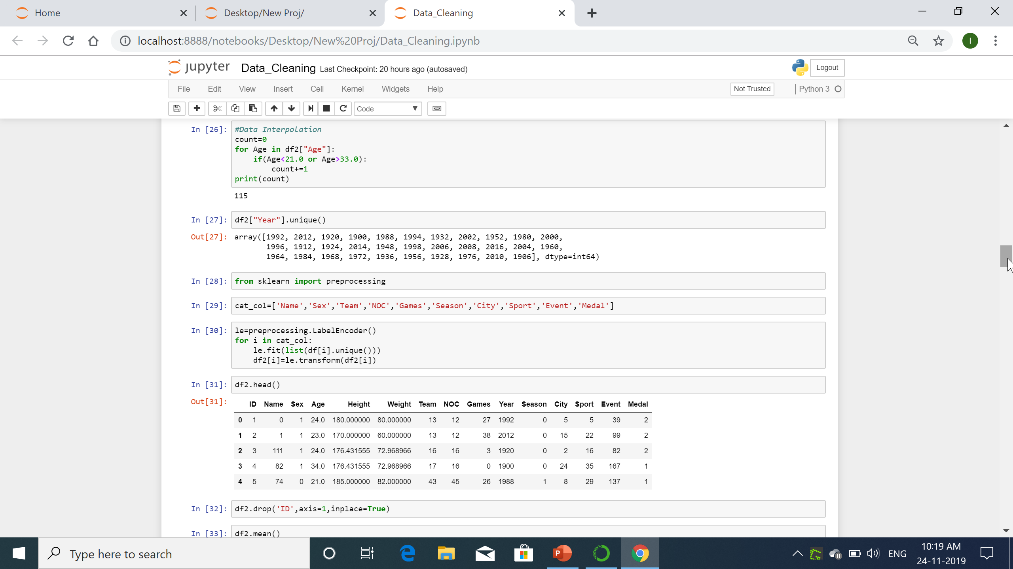
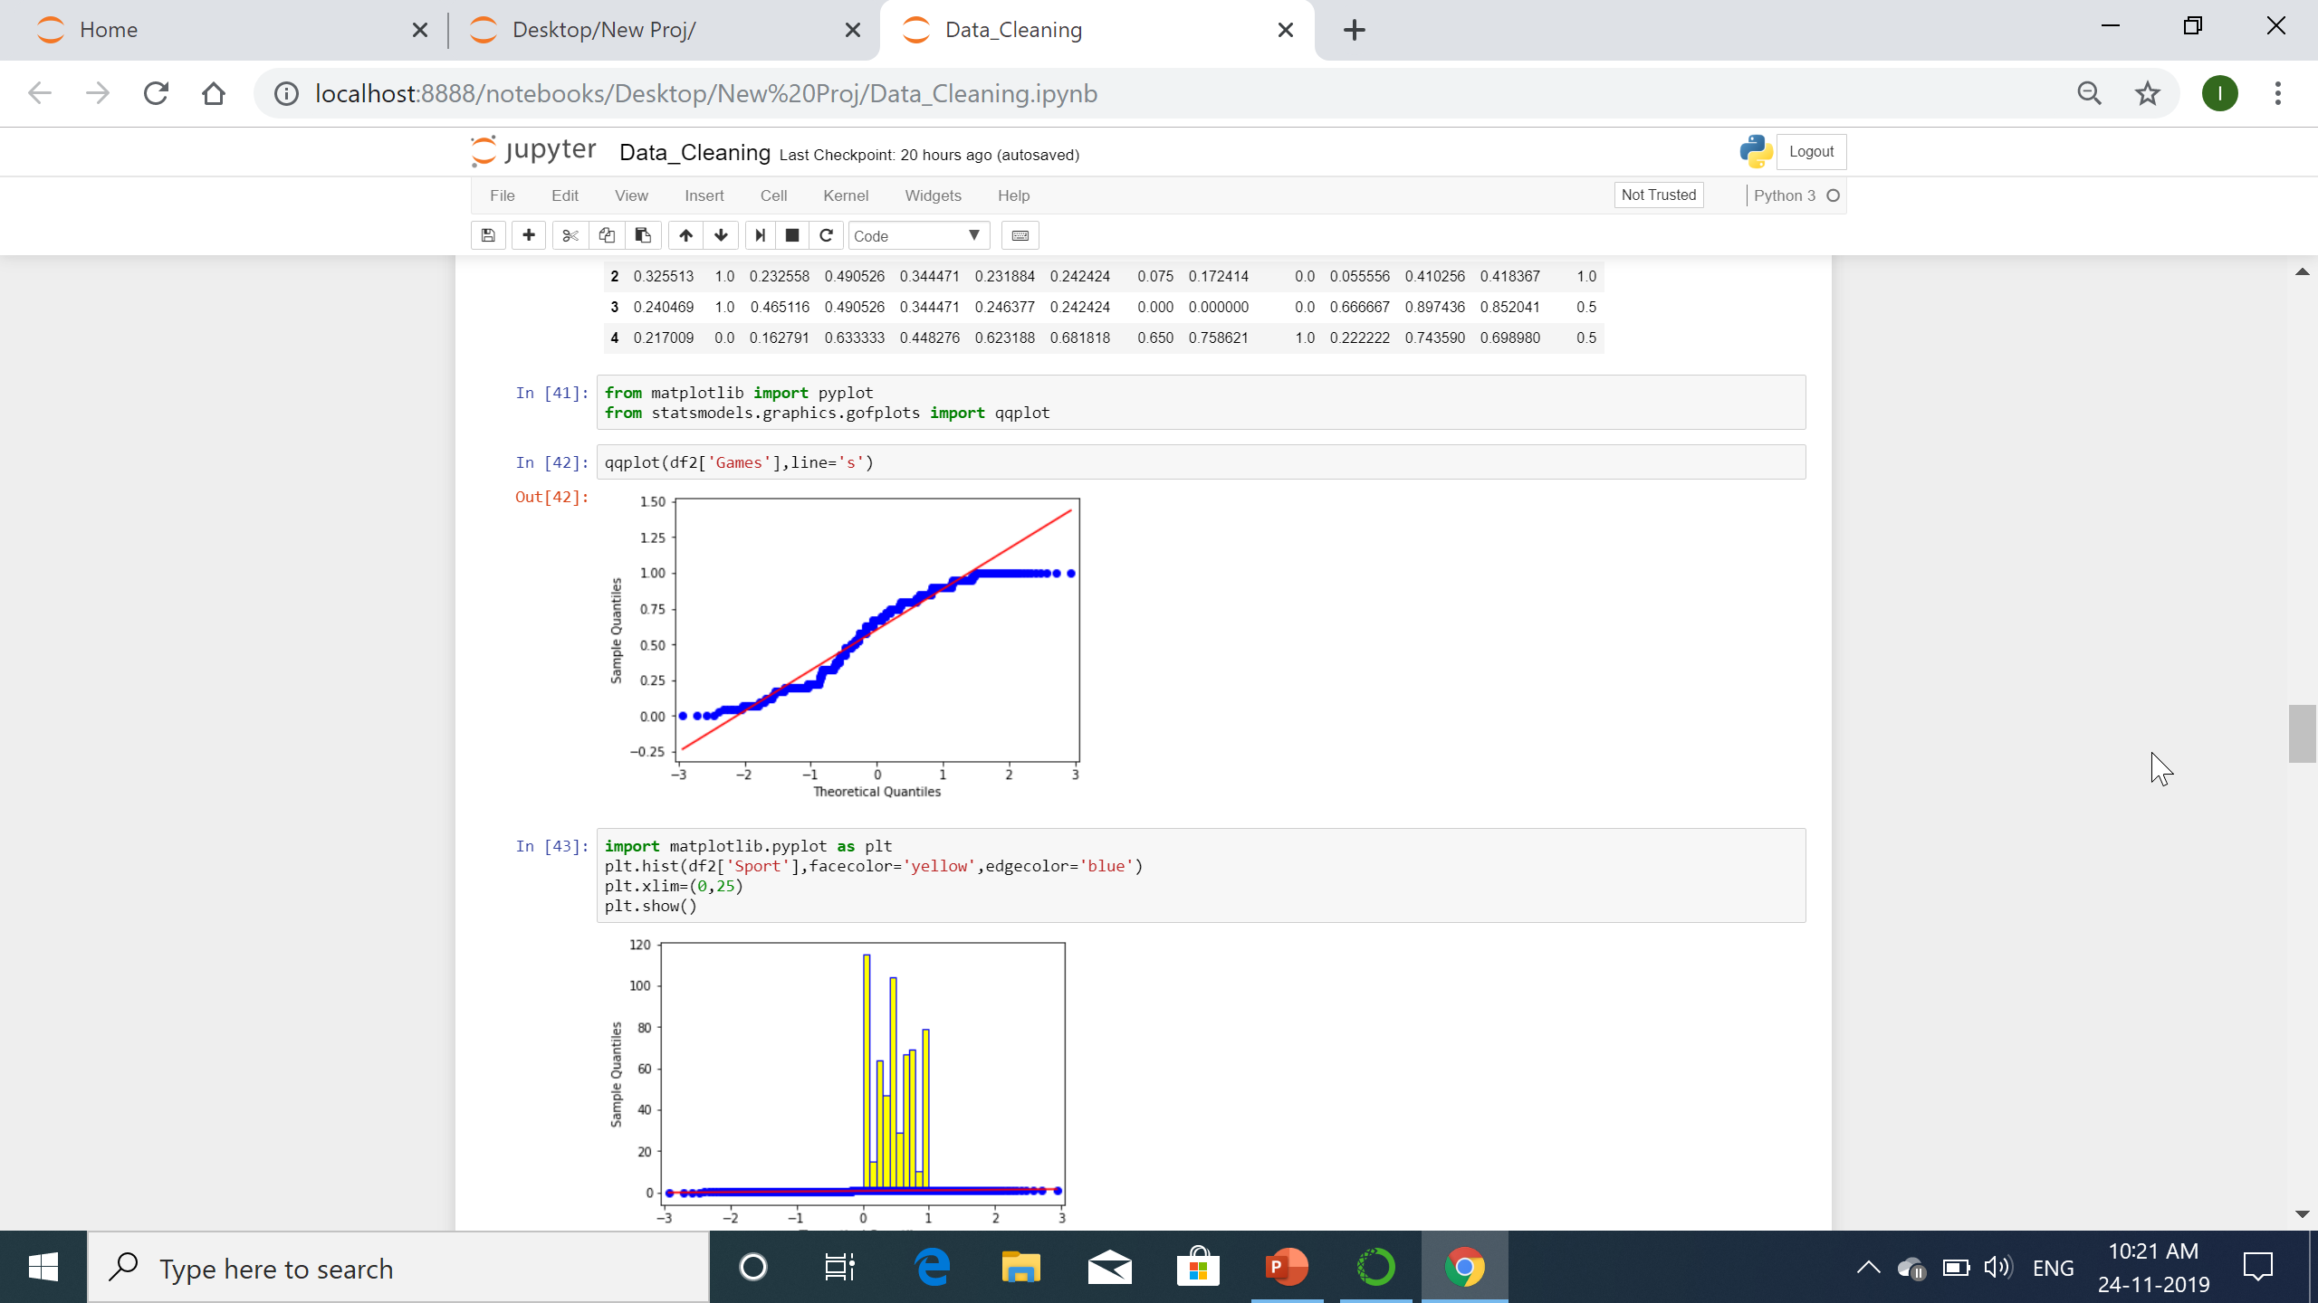
Data interpolation

Slide 11
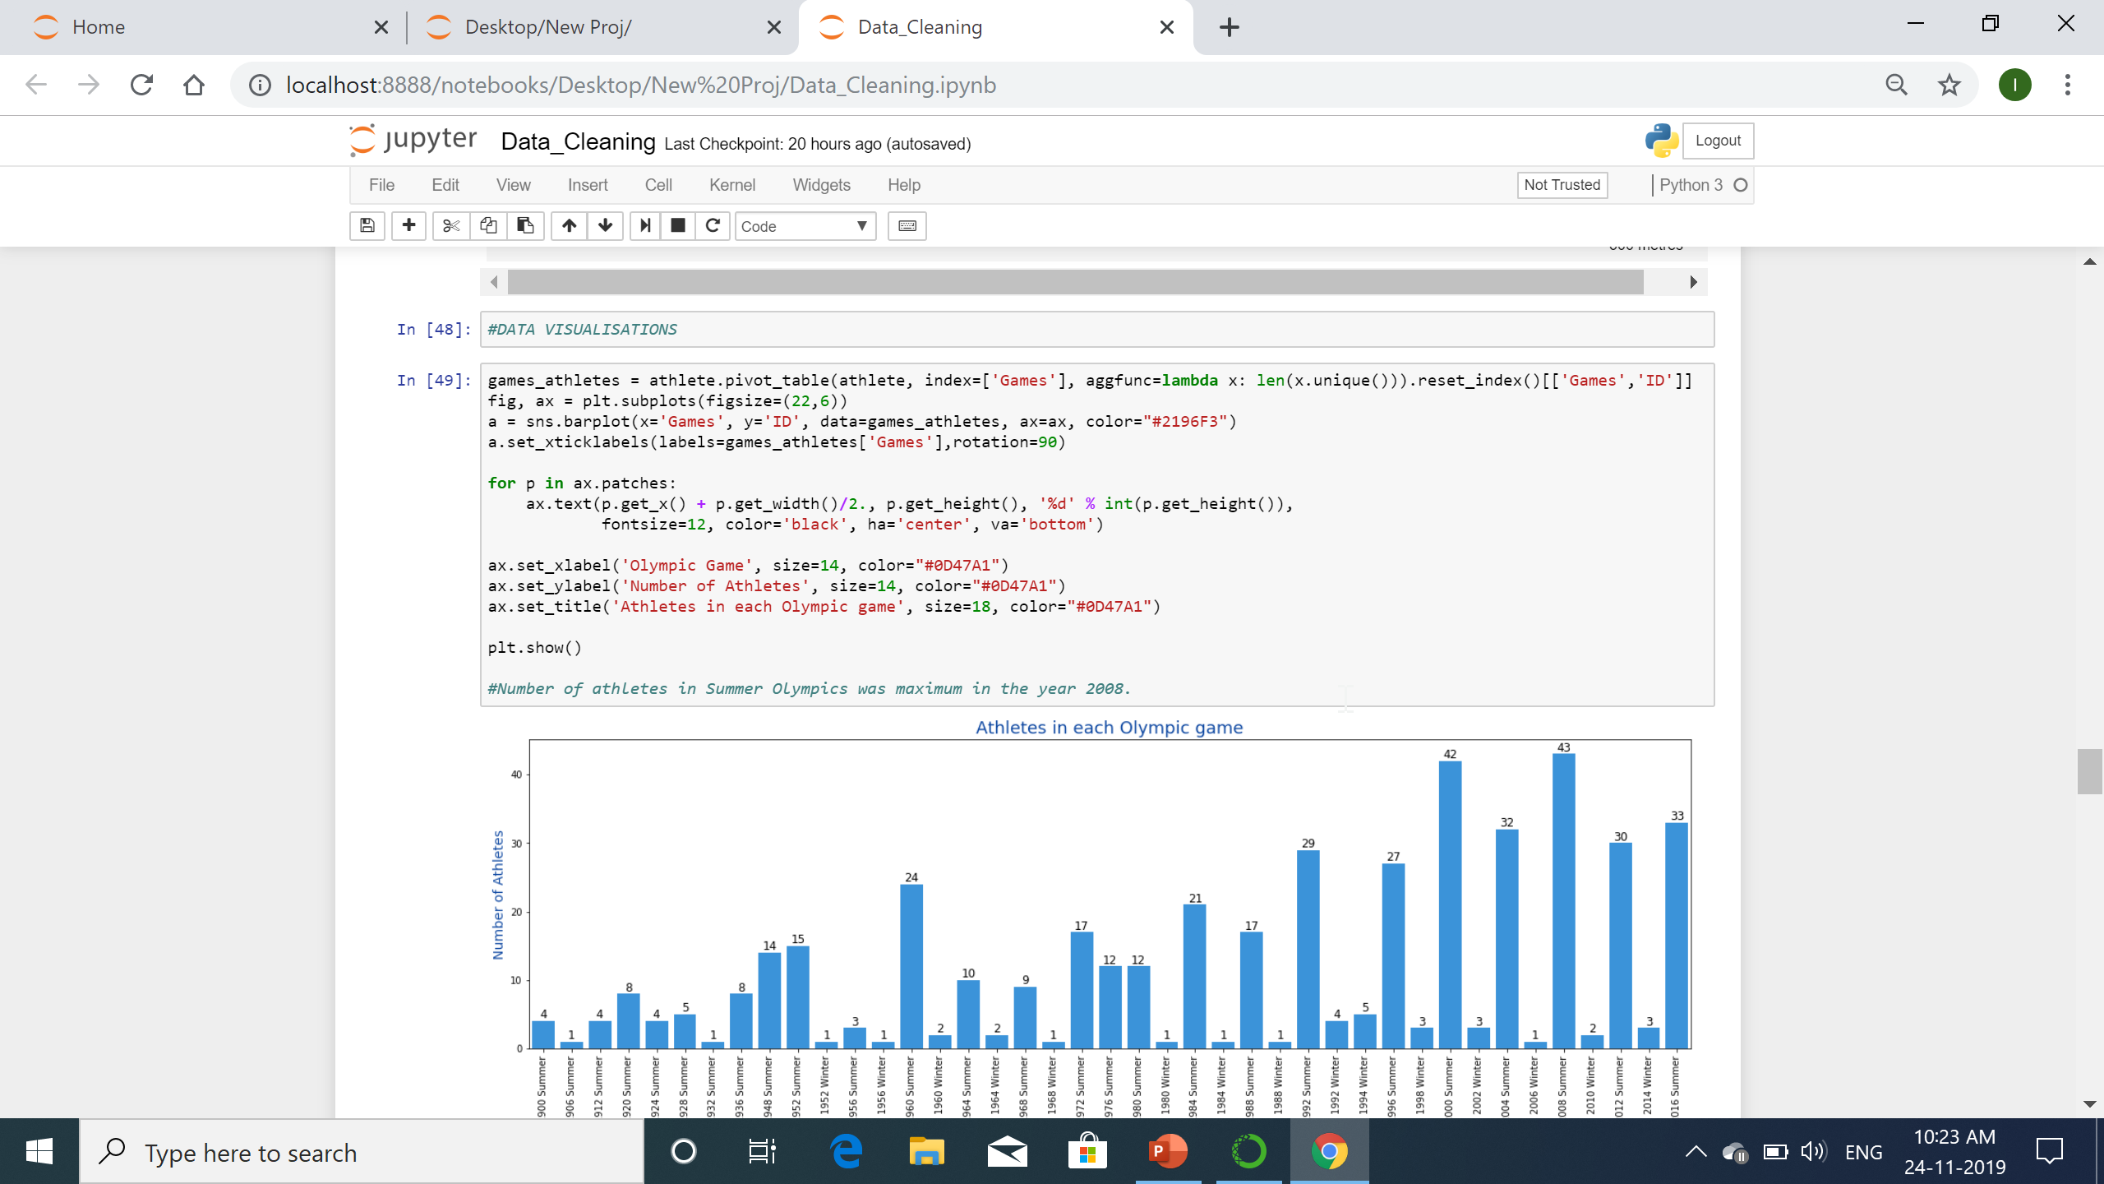
Data Visualisation
Data visualization is the graphical representation of information and data. By using visual elements like charts, graphs, and maps, data visualization tools provide an accessible way to see and understand trends, outliers, and patterns in data.

Slide 12
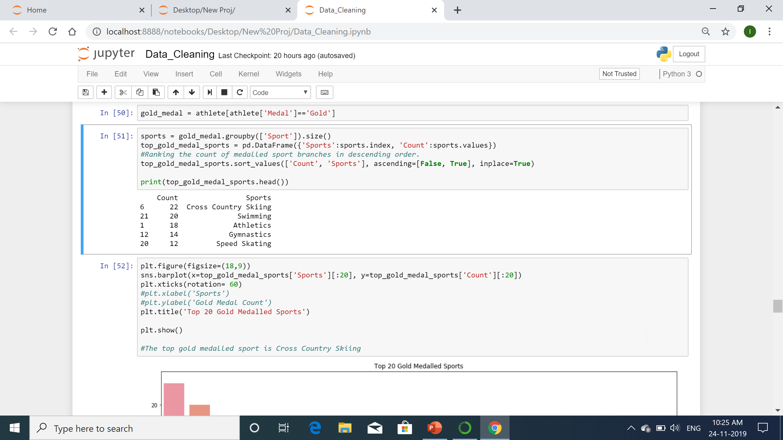
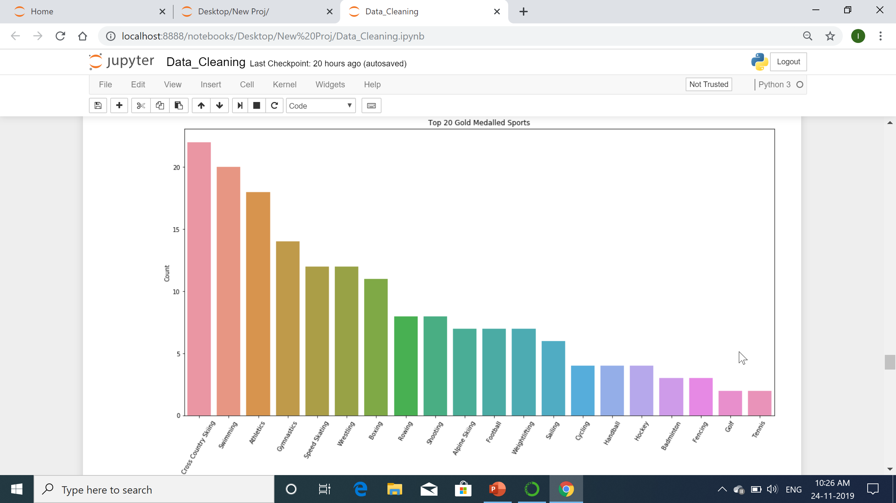
Top gold medal sports

Slide 13
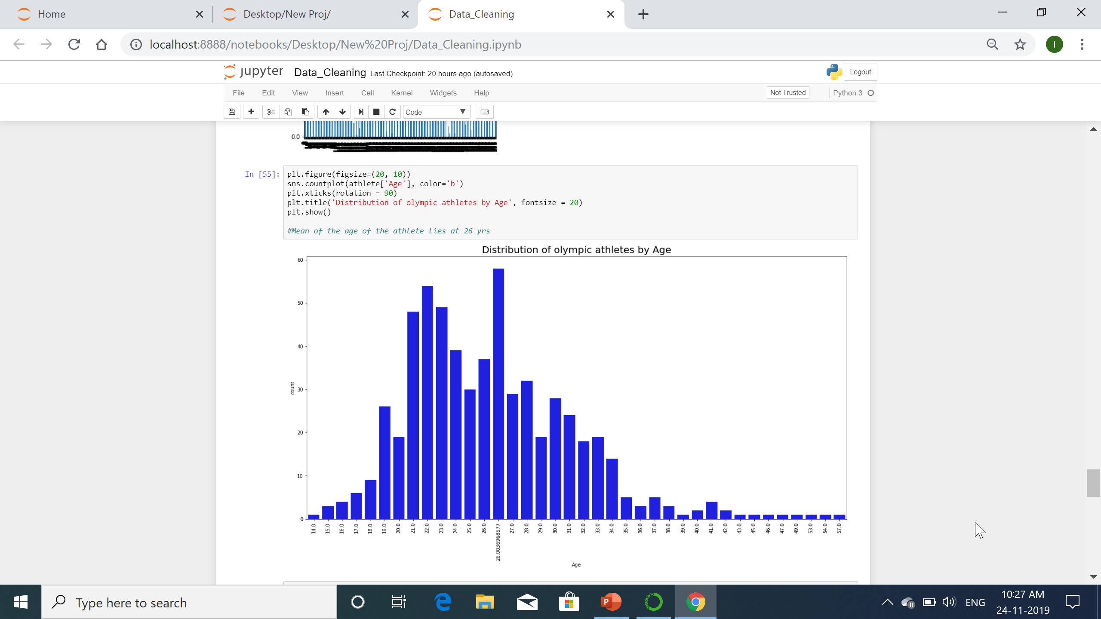
Distribution of athletes according to age

Slide 14
Hypothesis testing
Hypothesis testing is used to infer the result of a hypothesis performed on sample data from a larger population. the test tells the analyst whether or not his primary hypothesis is true. Statistical analysts test a hypothesis by measuring and examining a random sample of the population being analyzed.

Slide 15
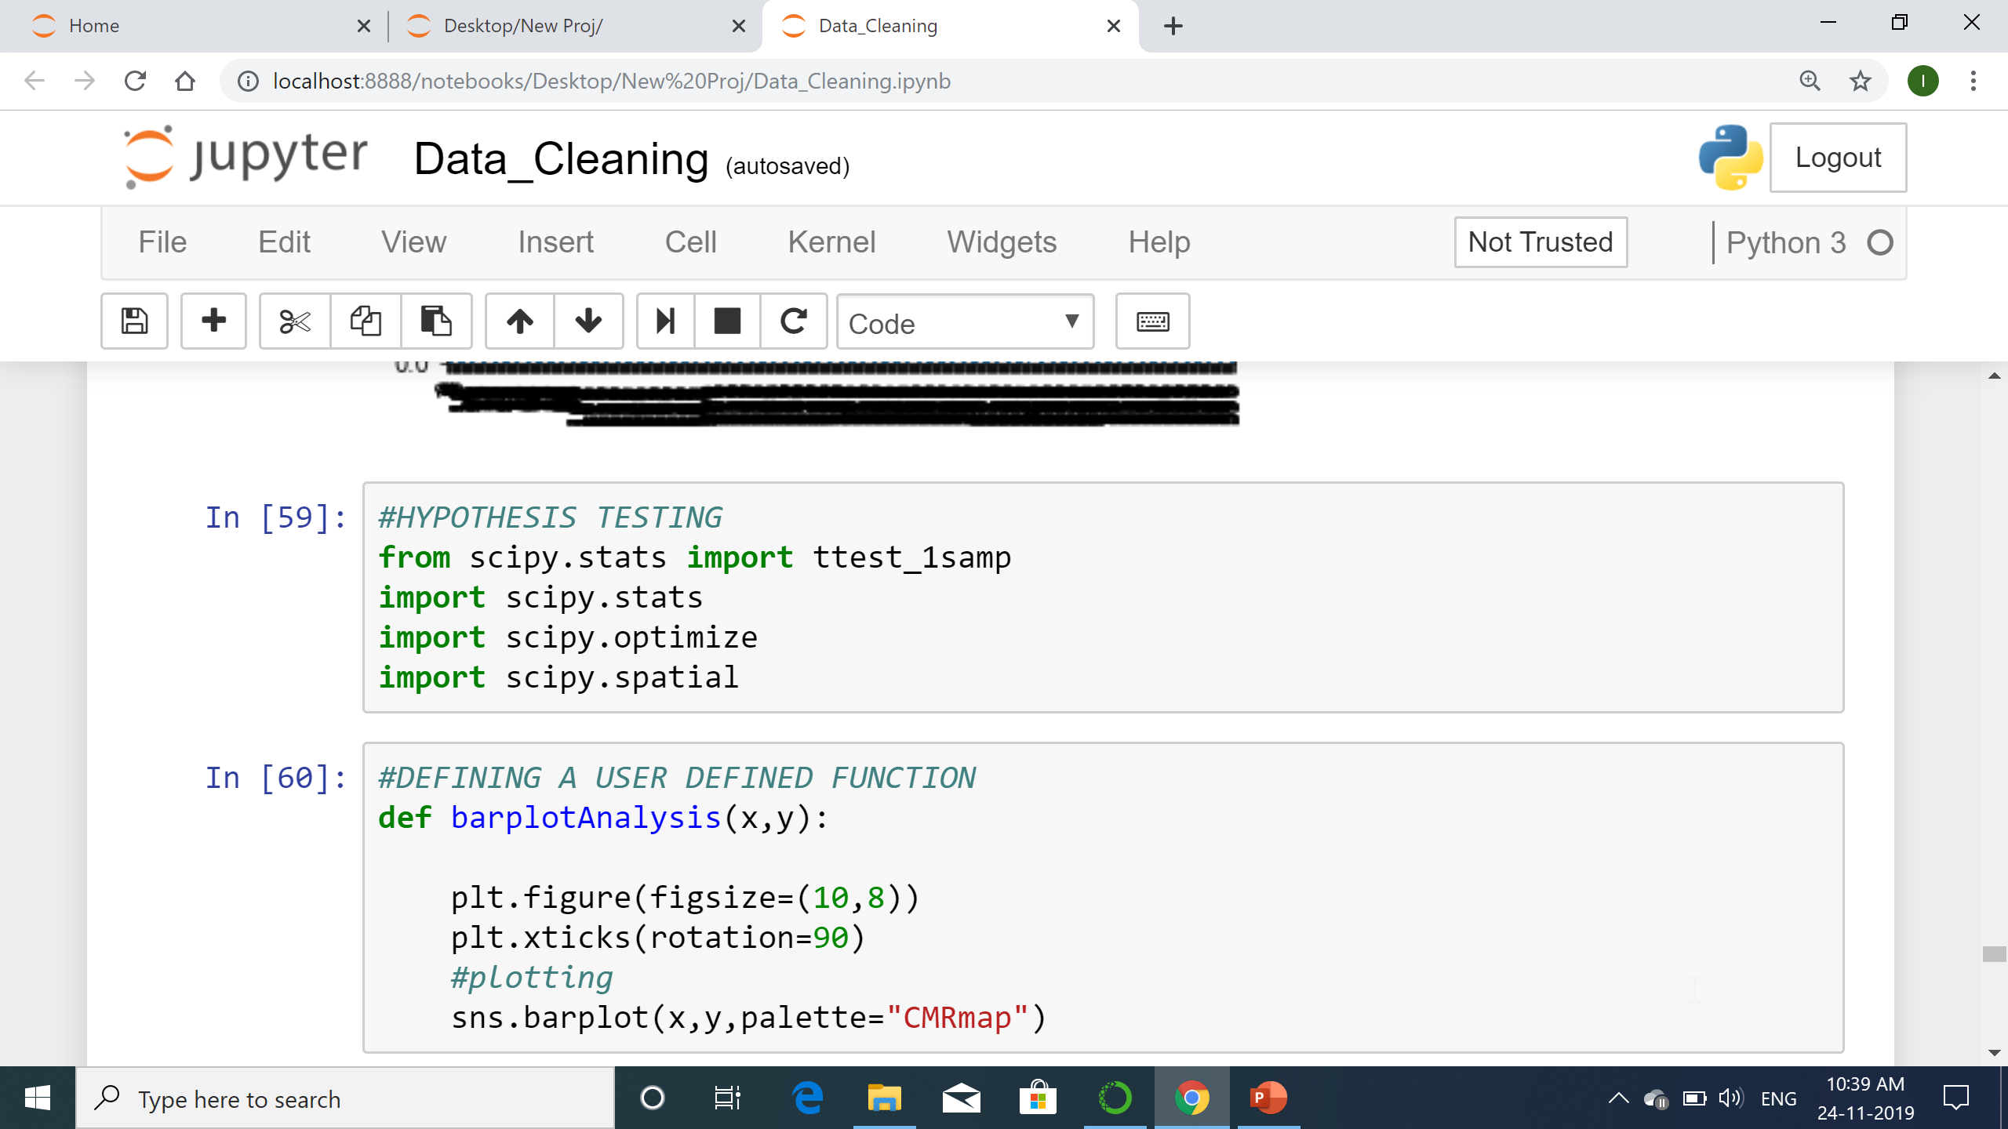
Hypothesis testing and user defined function

Slide 16
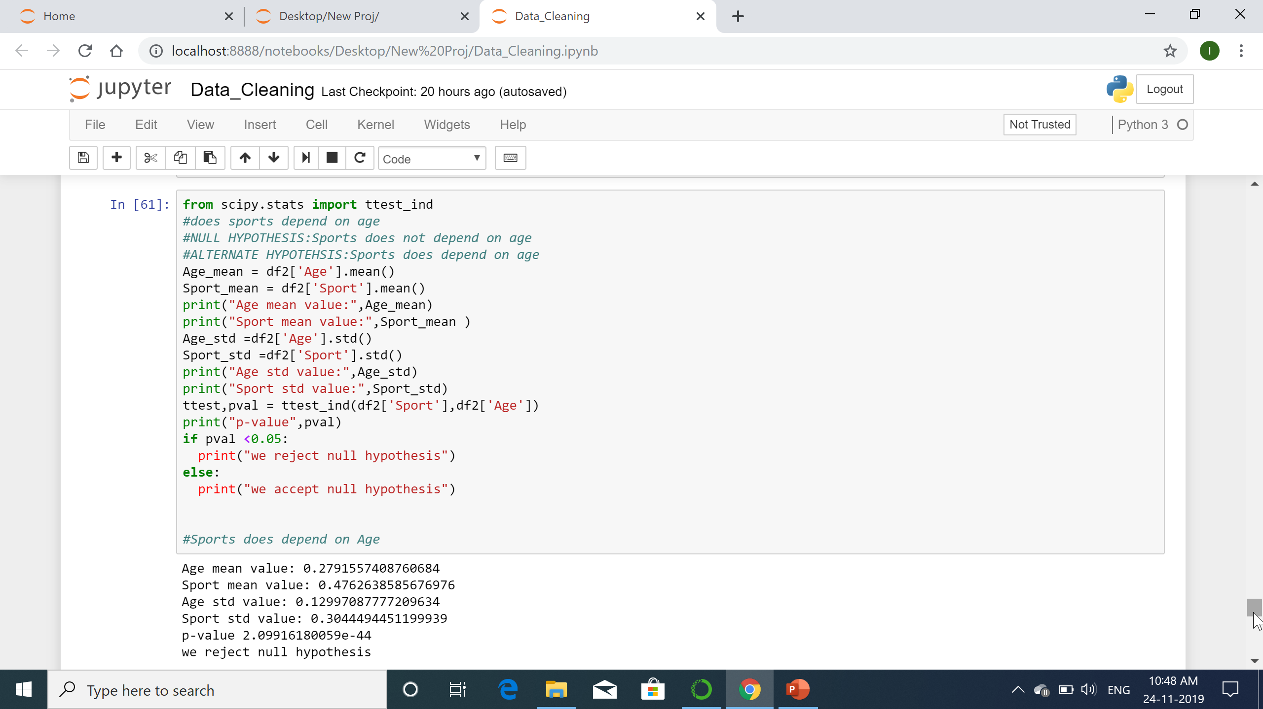
First hypothesis - Dependency of sport on age
NULL hypothesis- sports does not depend
Alternate hypothesis- sports does depend on age

Slide 17
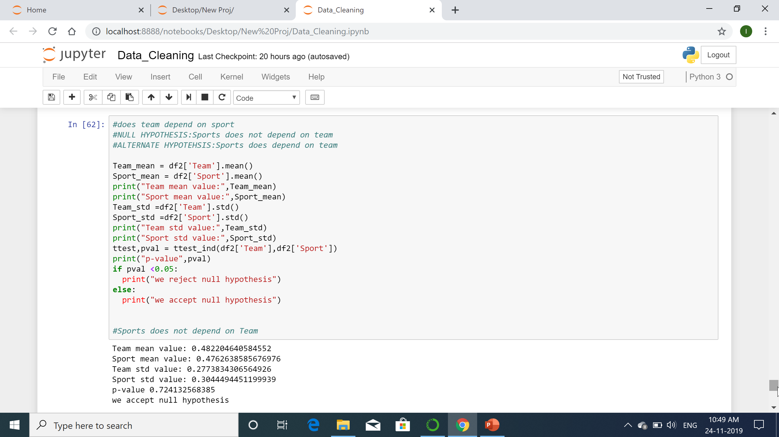
Second hypothesis- team dependency of sport
Null hypothesis- Sports does not depend on team
Alternate hypothesis – Sports does depend on team

Slide 18
Correlation
In statistics, dependence or association in any statistical relationship, whether causal or not, between two random variables or bivariate data. In the broadest sense correlation is any statistical association, though it commonly refers to the degree to which a pair of variables are linearly related.
Correlation is used to describe how data sets are related to one another. Correlation can be seen when two sets of data are graphed on a scatter plot, which is a graph with an X and Y axis and dots representing the data points.

Slide 19
Types of correlation
Three types of correlation-
Positive correlation
Negative correlation
No correlation
Strong (+/-) correlation
Weak (+/-) correlation
Perfect correlation

Slide 20
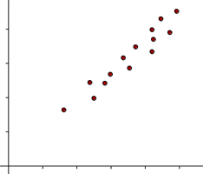
Positive Correlation
Positive correlation means that as one data set increases, the other data set increases as well.
Typically, positively correlated data sets are seen as a line the goes up and to the right on a scatter plot.

Slide 21
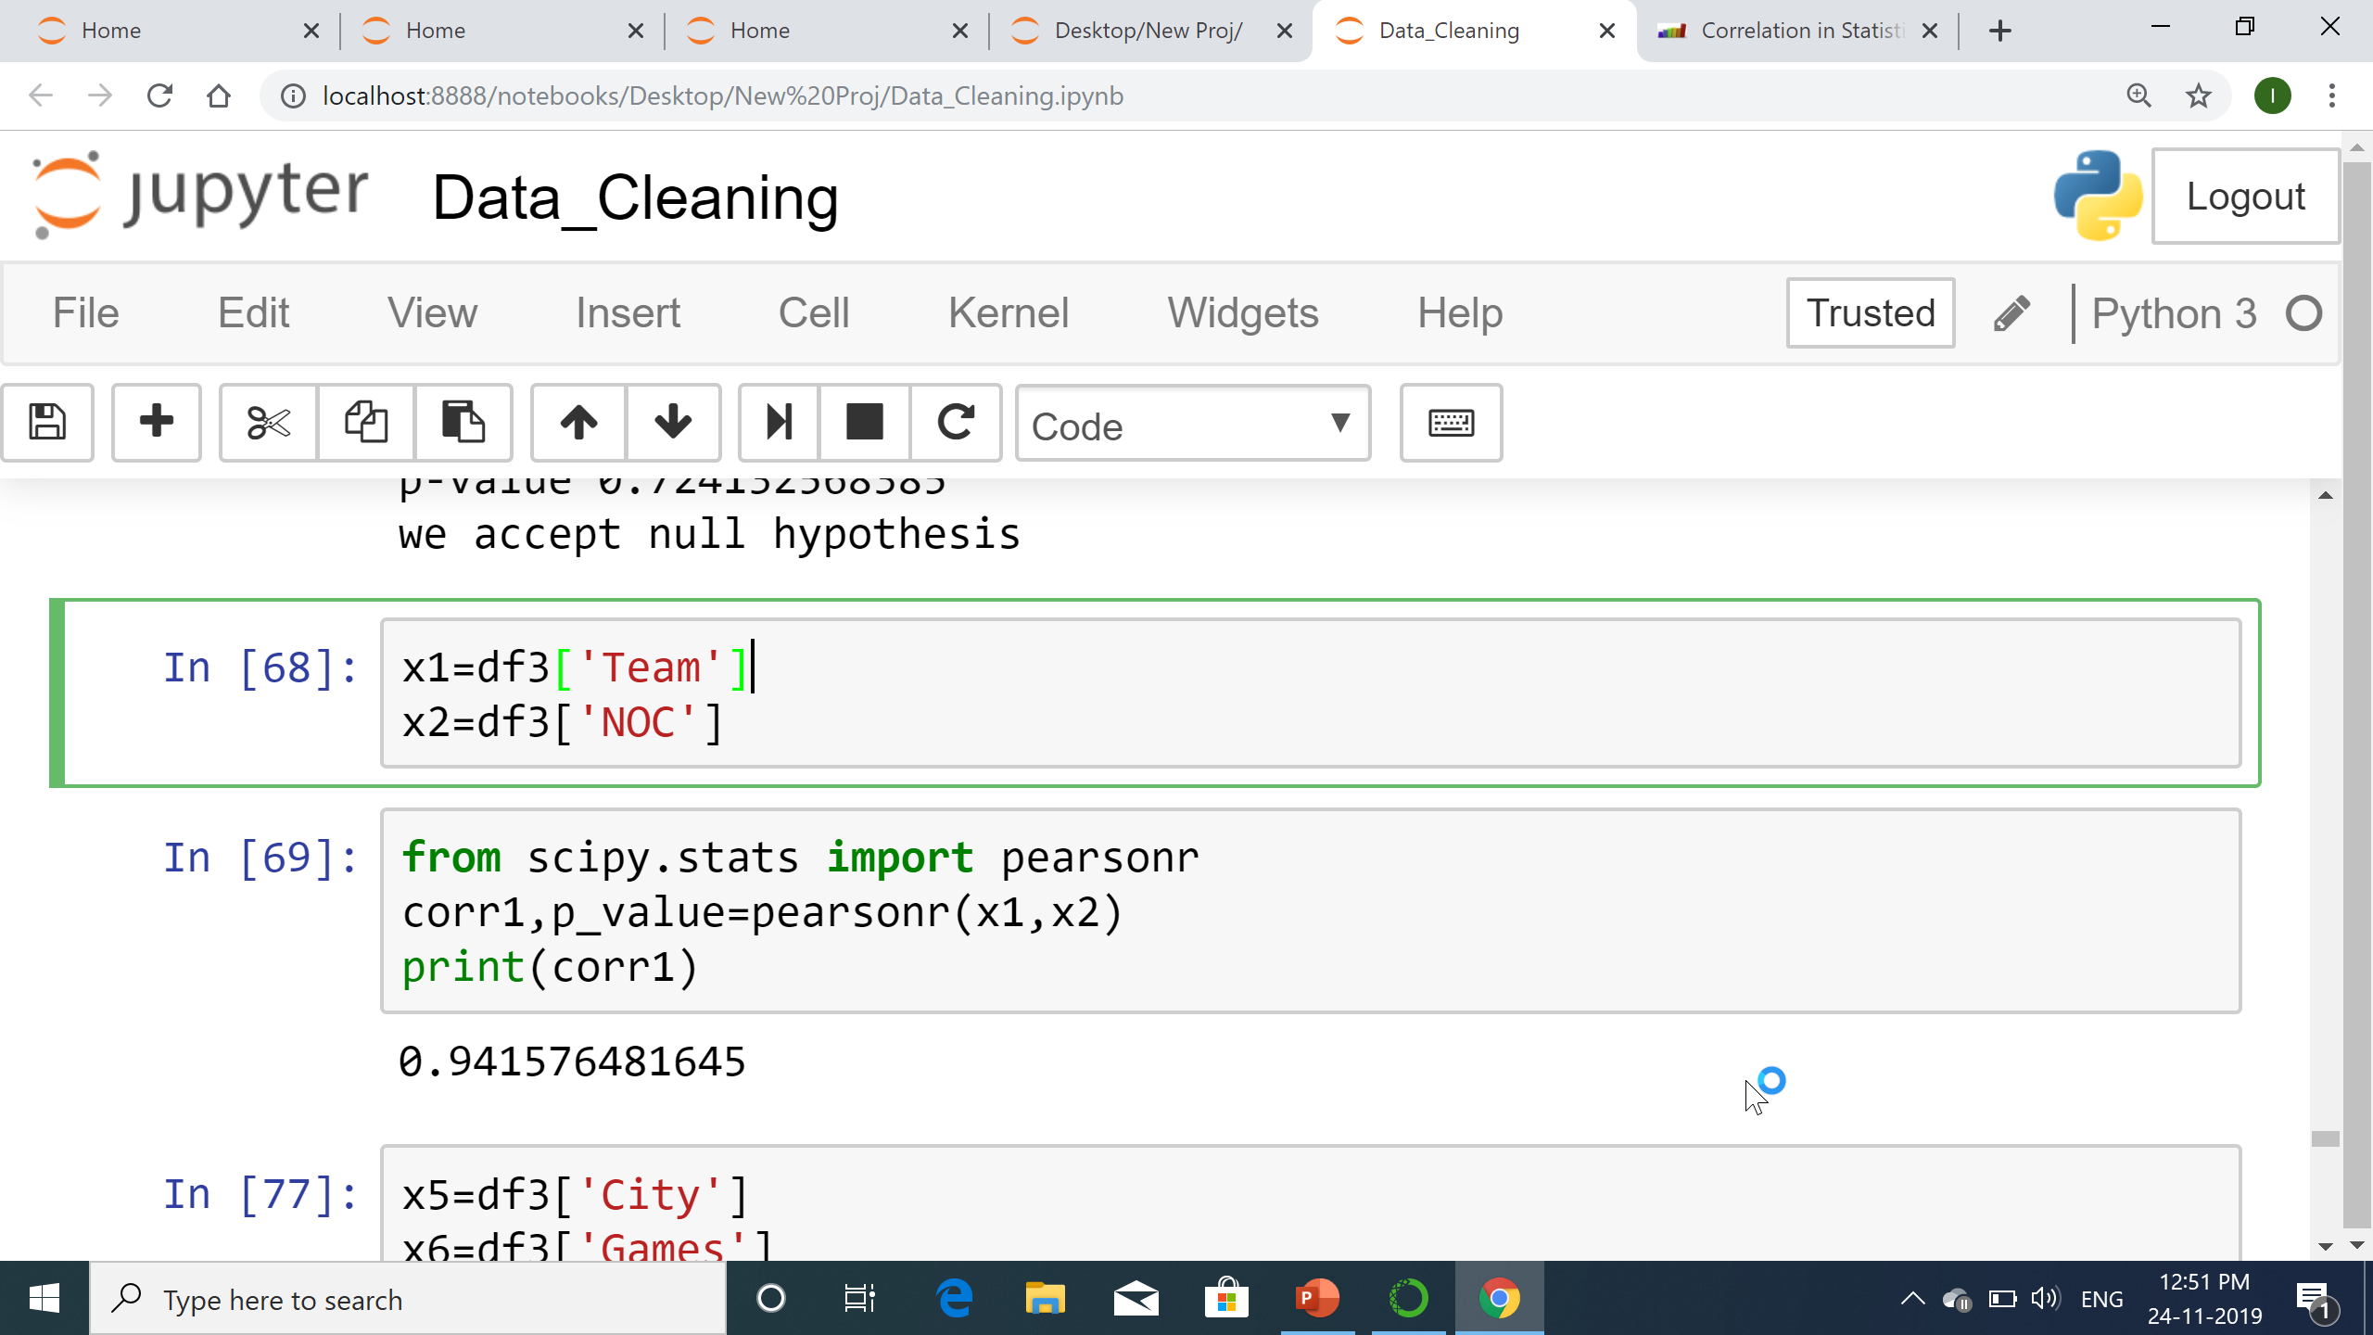
Correlation between Team and NOC
The correlation between
team and NOC (country
short form) is strong
positive correlation,
as correlation coefficient is is 0.9415

Slide 22
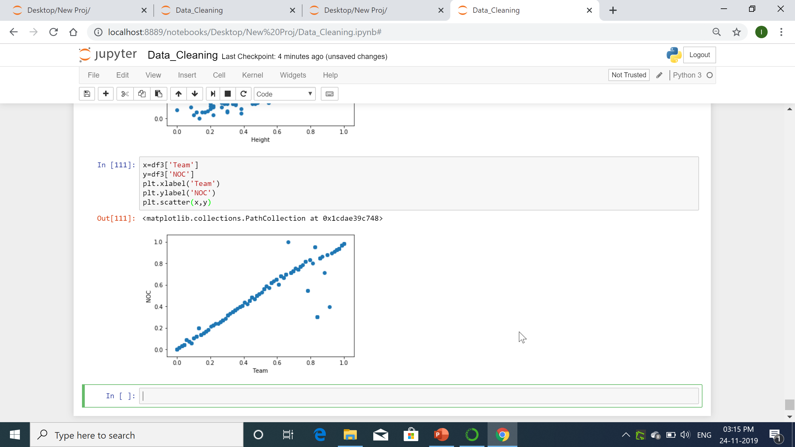
Scatter plot for team vs NOC

Slide 23
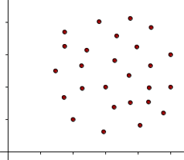
No correlation
No correlation means that the two sets of data are not related at all. In other words, this means that one set of data does not increase or decrease with the other.
No correlation is typically seen when the data points are very spread out

Slide 24
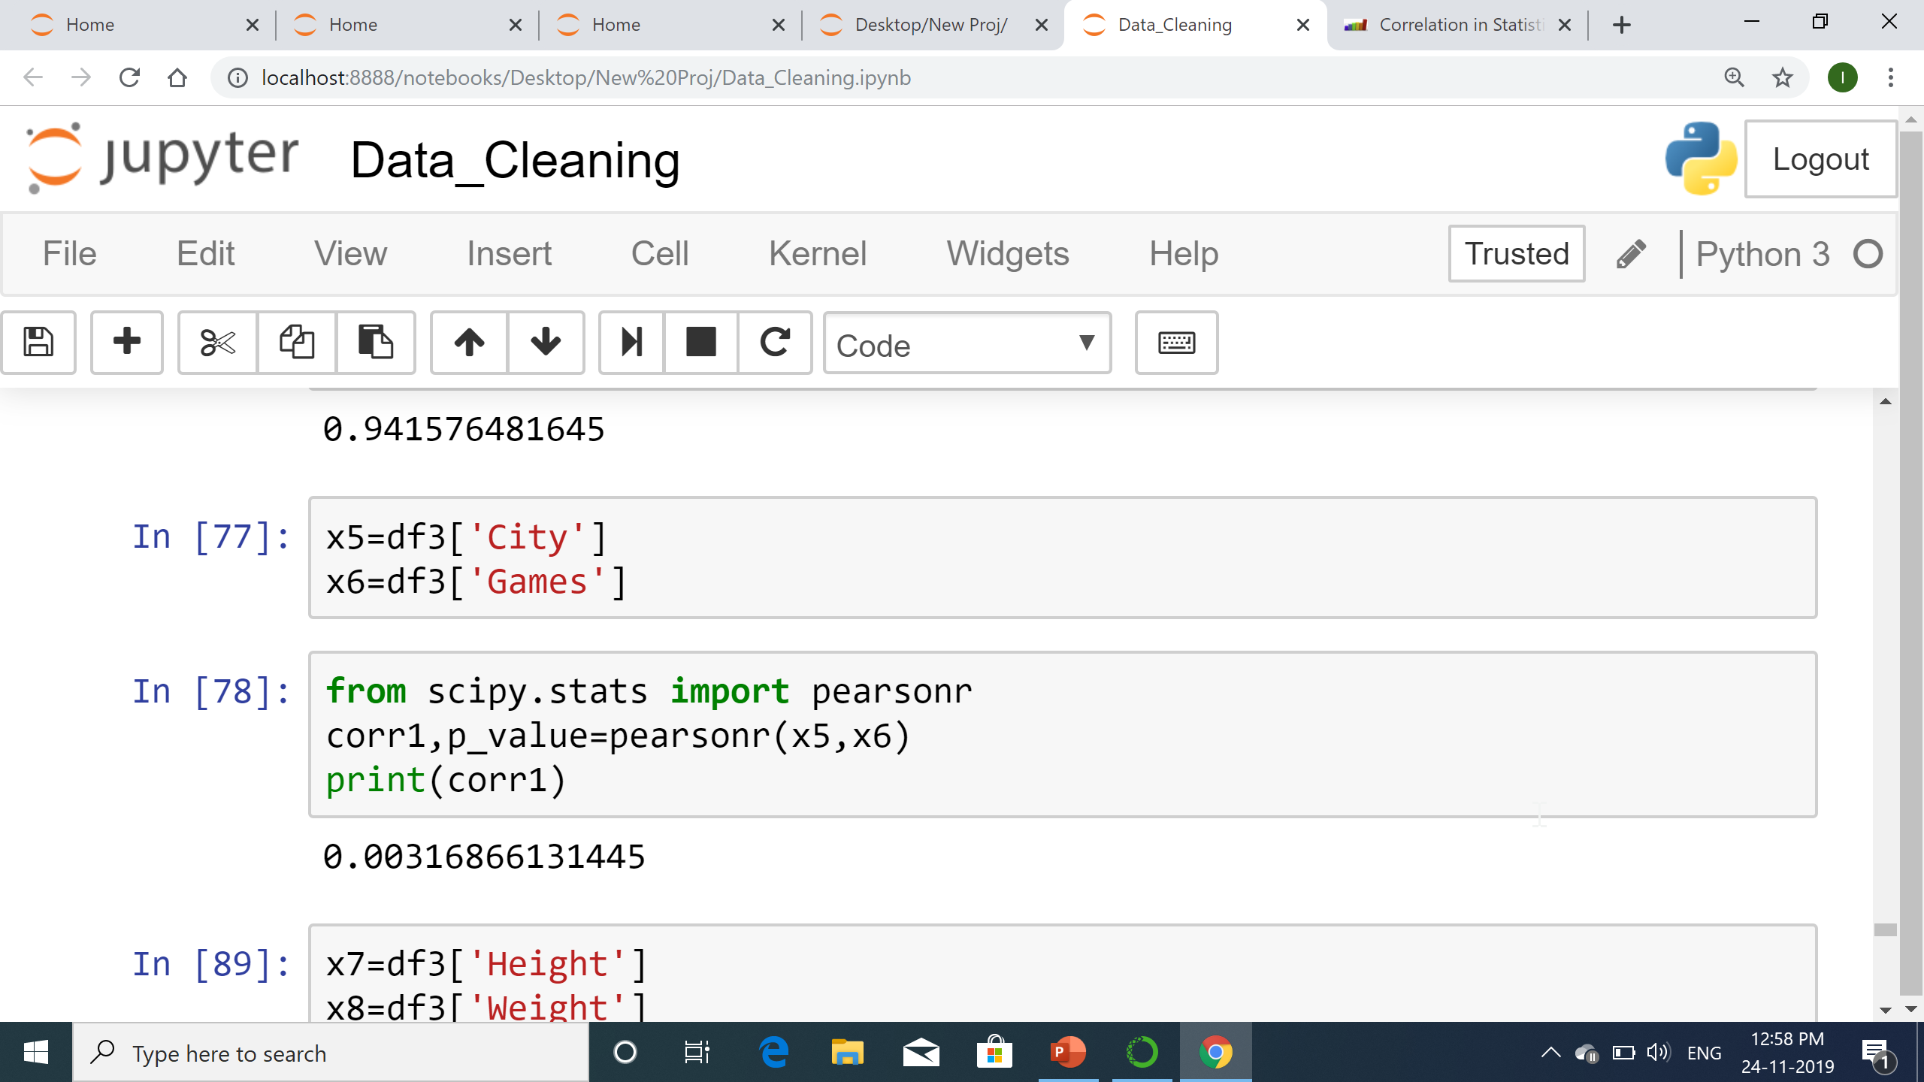
Correlation between city and games
Its approximately no correlation as correlation coefficient is 0.003

Slide 25
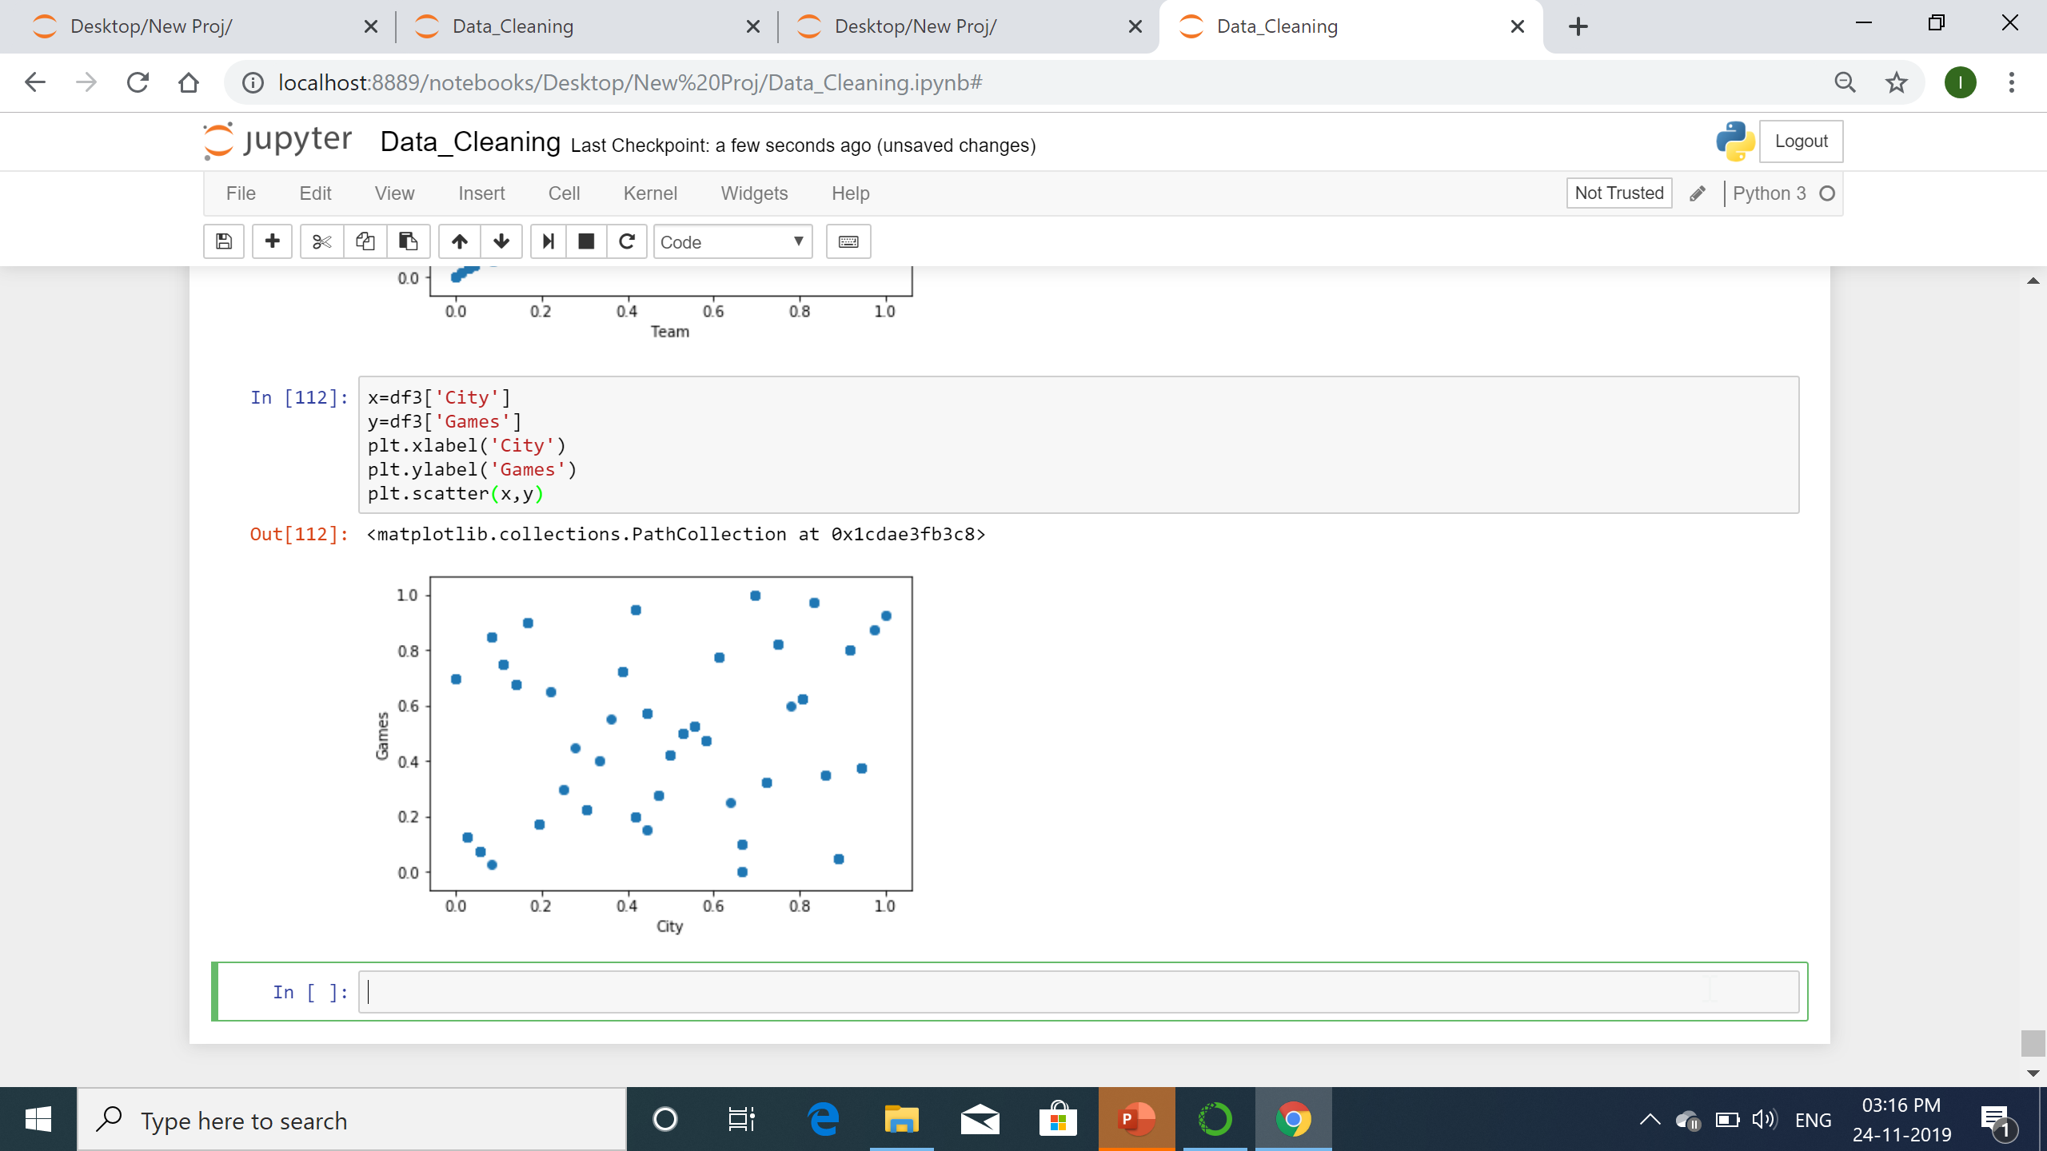
Scatter plot for city vs games

Slide 26
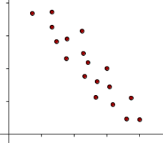
Negative Correlation
Negative correlation occurs when an increase in one variable decreases the value of another.
The line corresponding to the scatter plot is a decreasing line.

Slide 27
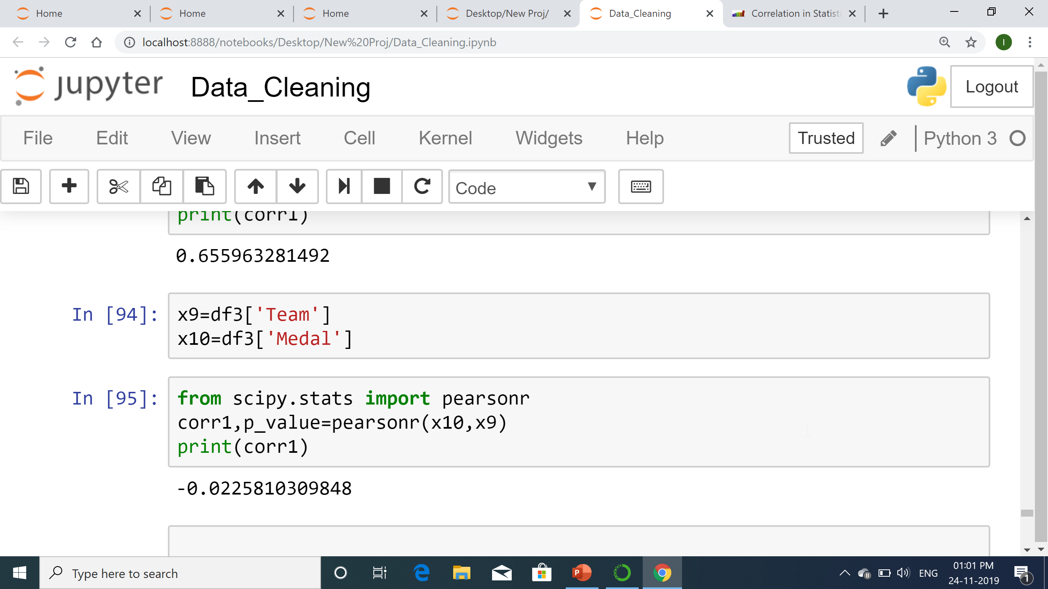
Correlation between Team and Medal
Negative correlation as coefficient is -0.022

Slide 28
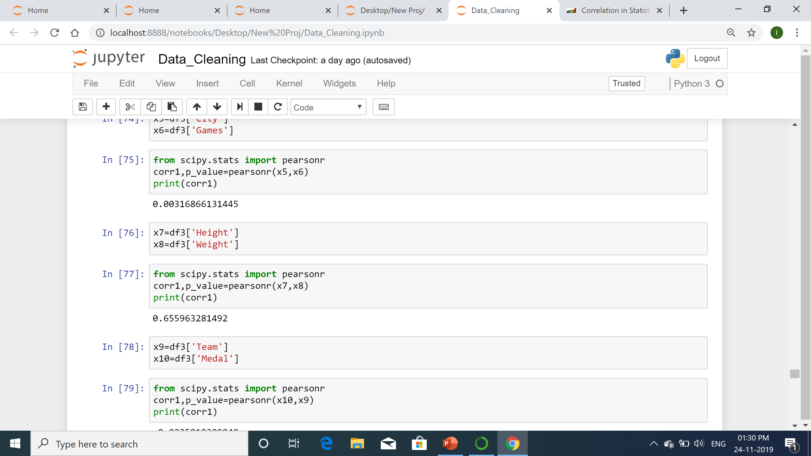
Strong and weak correlation
A correlation is stronger the closer the points are located to one another on the line. The correlation between team and noc is strong positive correlation
A correlation is weaker the farther apart the points are located to one another on the line. Correlation between height and weight is weak positive.

Slide 29
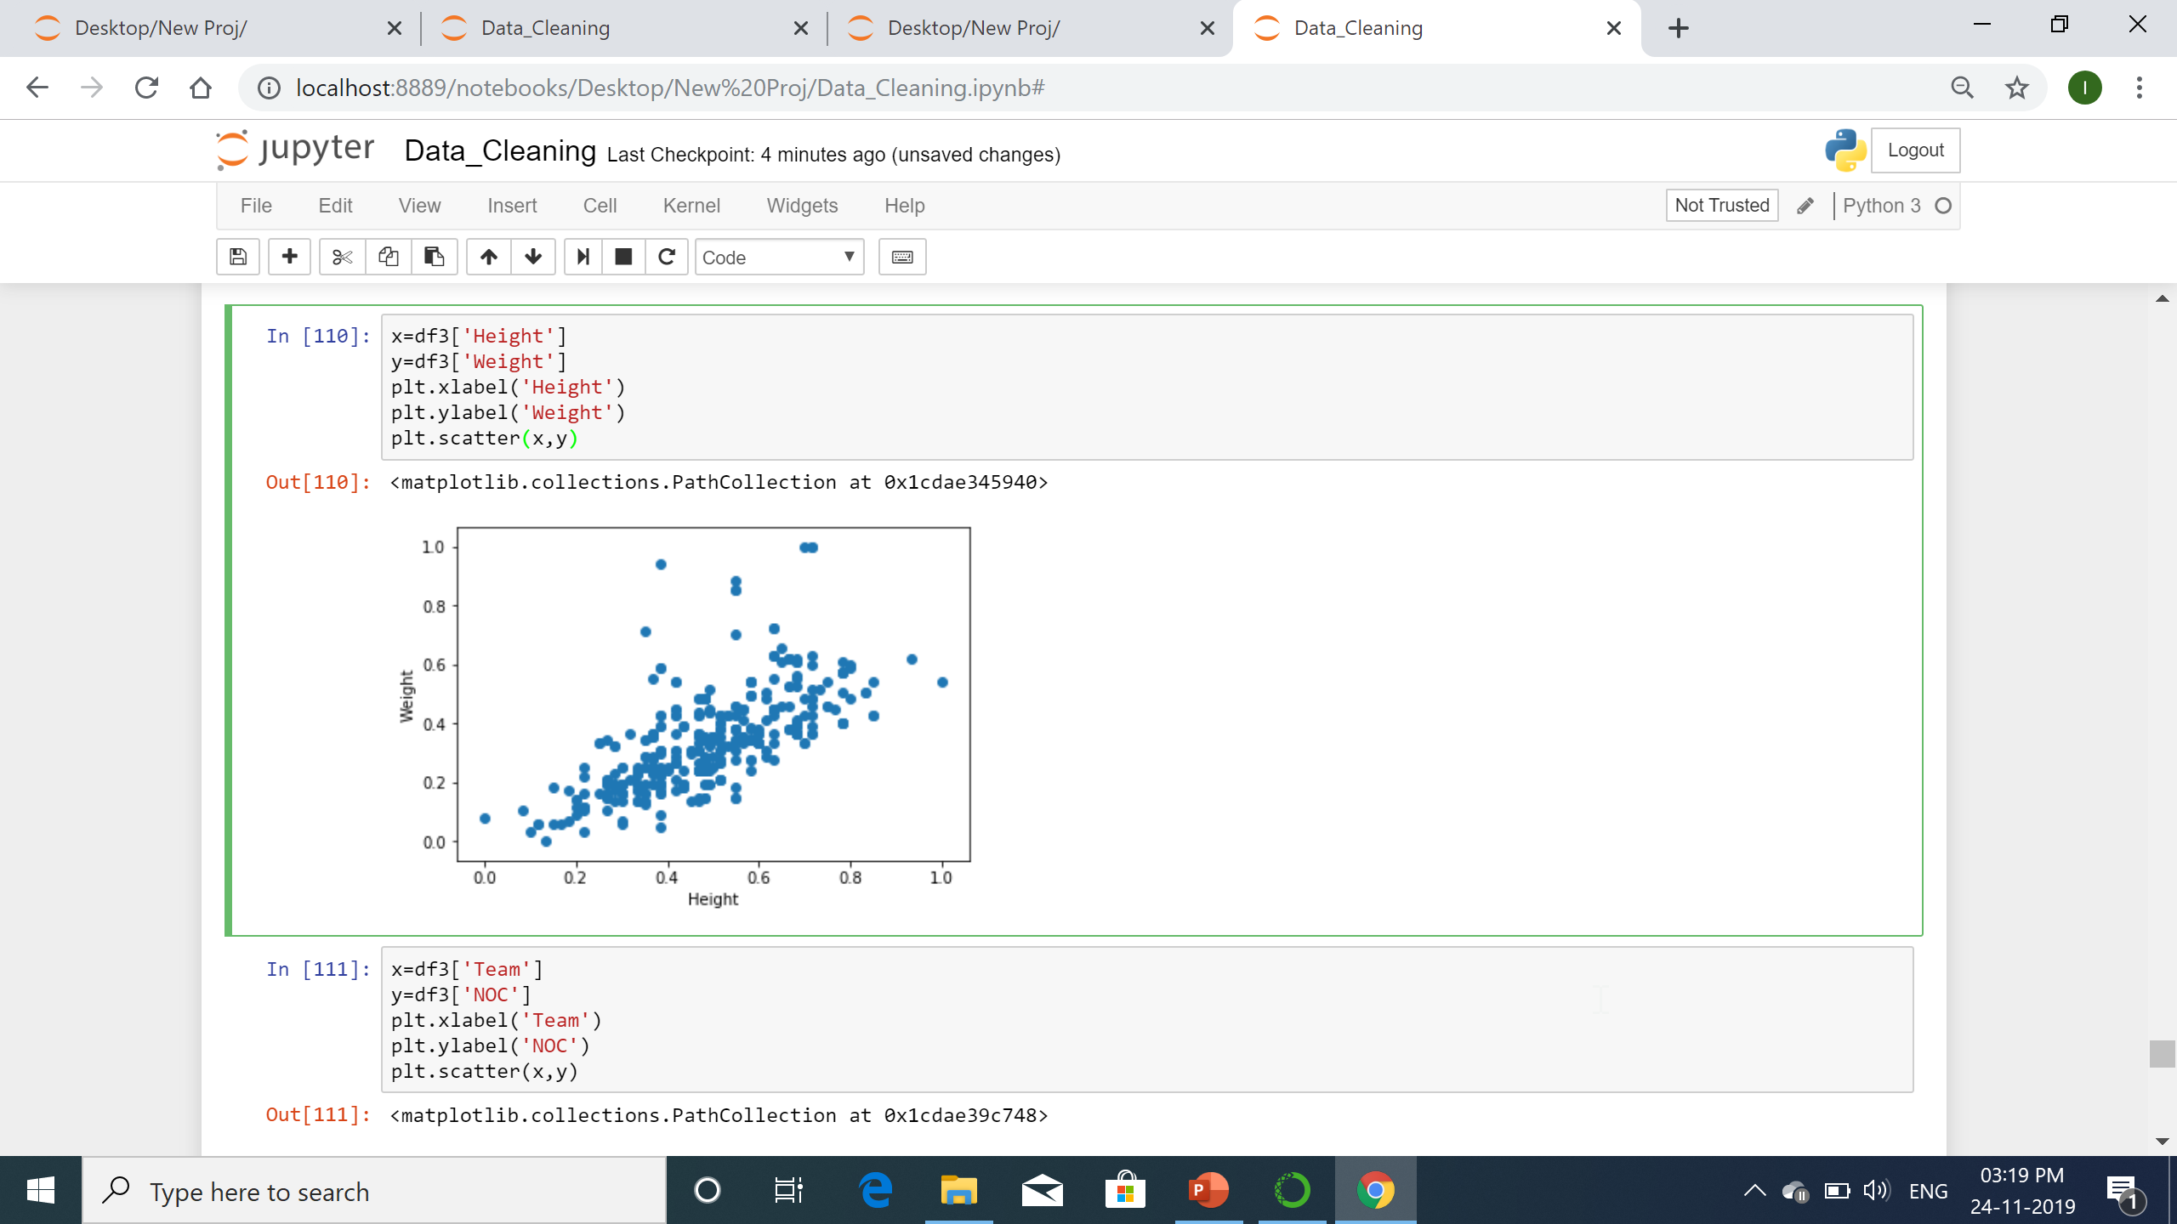
Weak correlation between Height and weight

Slide 30
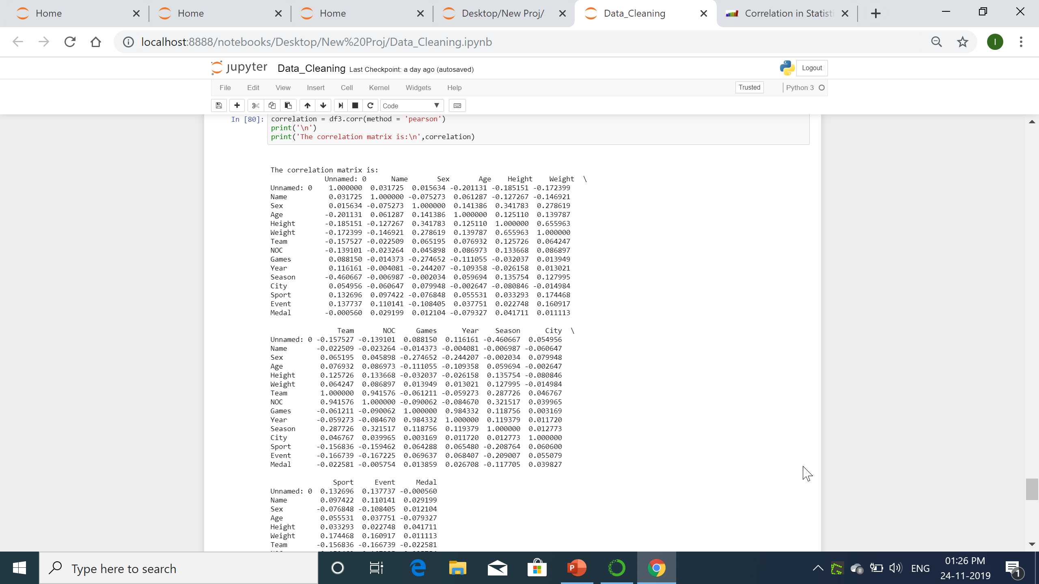
Correlation Matrix
A correlation matrix is a table showing correlation coefficients between variables. Each cell in the table shows the correlation between two variables.

Slide 31
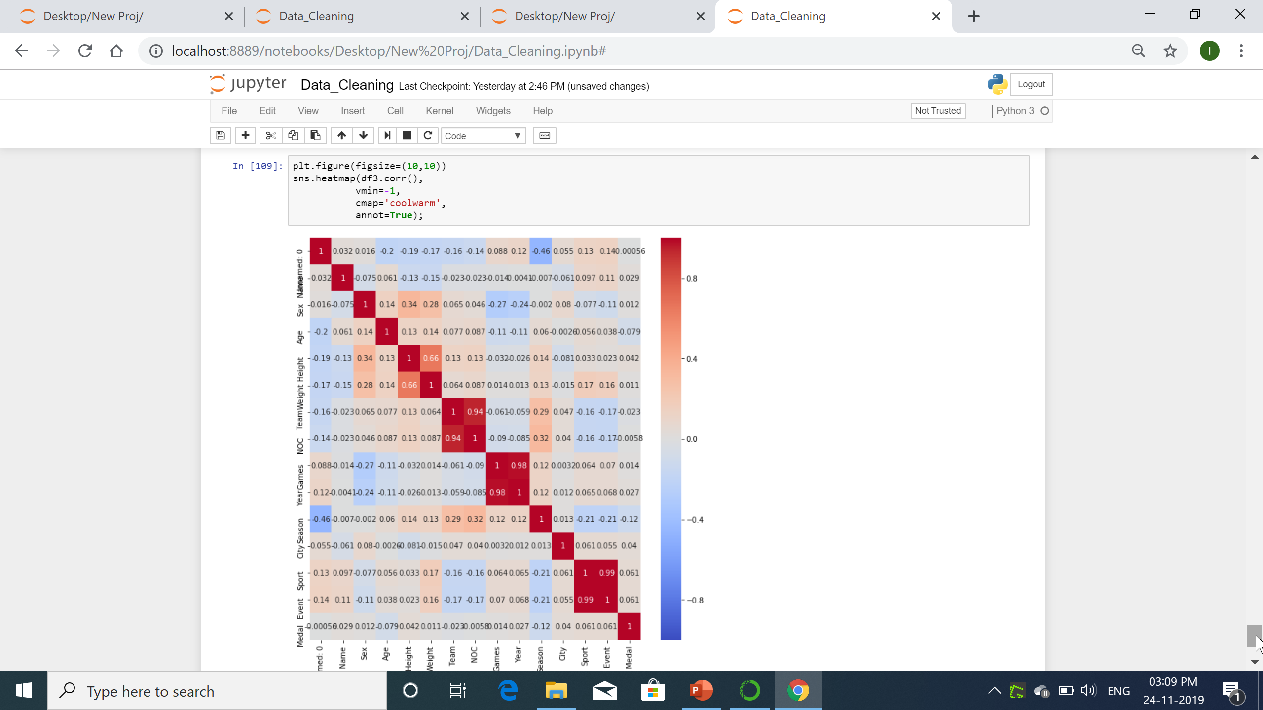
Heat Map
A correlation heatmap uses colored cells, typically in a monochromatic scale, to show a correlation matrix (table) between two discrete dimensions or event types.

